Slide 1
Supervised Machine Learning: Regression and Classification
FROM COURSERA

Slide 2
What is Machine Learning?
It is the field of study that gives computers the ability to learn without being explicitly Programmed.
Machine Learning Algorithms
Supervised Learning
Unsupervised Learning

Slide 3
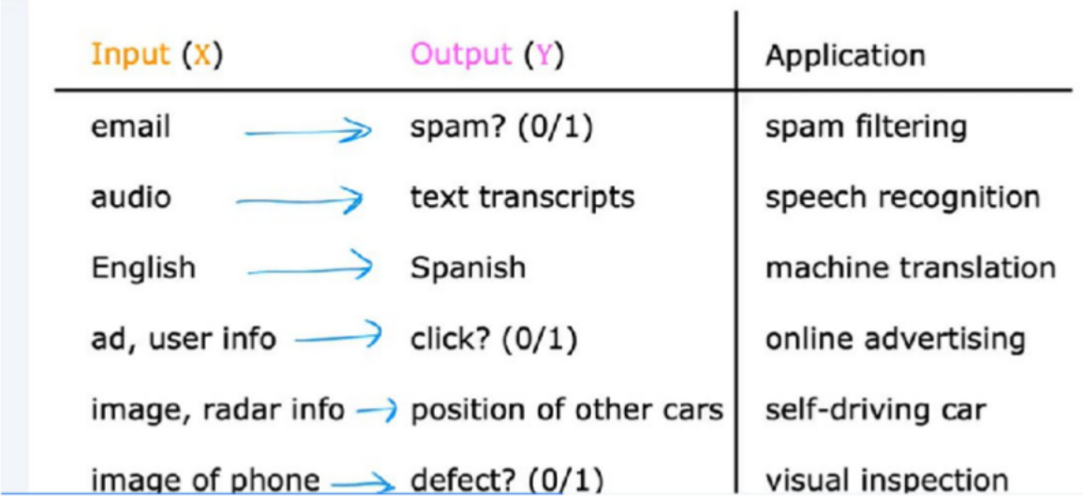
Supervised Learning
Supervised machine learning or more commonly, supervised learning, refers to algorithms that learn x to y or input to output mappings.
The key characteristic of supervised learning is that you give your learning algorithm examples to learn from. That includes the right answers, whereby right answer, I mean, the correct label y for a given input x.

Slide 4
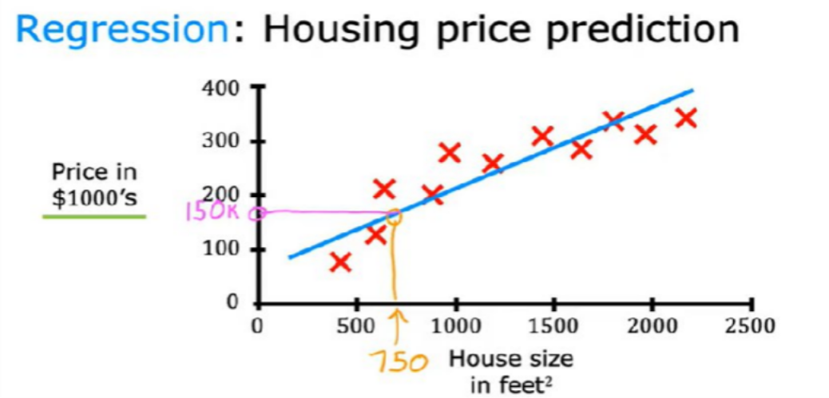
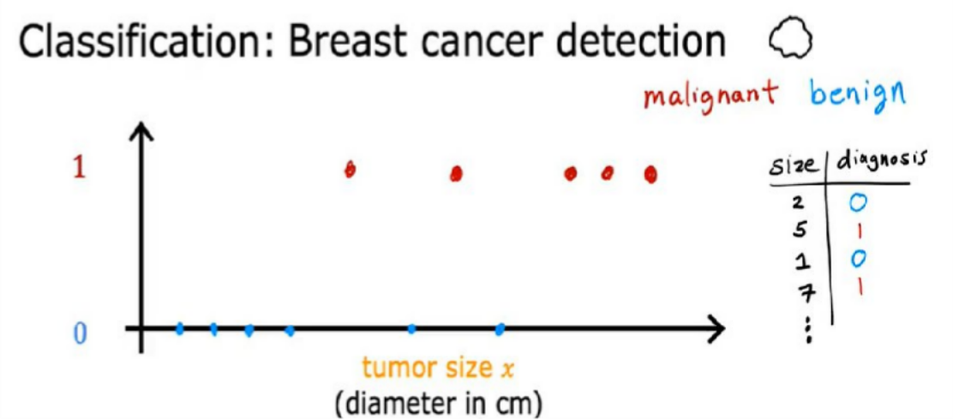
There are 2 types under Supervised Learning
Regression- supervised learning algorithm learns to predict numbers out of infinitely many possible numbers.Example House price prediction
Classification-there are only two possible outputs.Example:Cancer detection

Slide 5
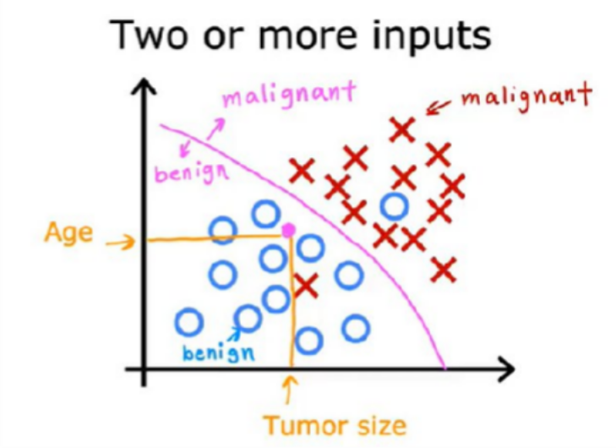
When there are multiple inputs in the data,Example-age and size of tumor are inputs and detect it is malignant or beningn tumor what the learning algorithm might do is find some boundary that separates out the malignant tumors from the benign ones. So the learning algorithm has to decide how to fit a boundary line
through this data. The boundary line found by the learning algorithm would help the doctor with the diagnosis.
In this case the tumor is more likely to be benign.

Slide 6
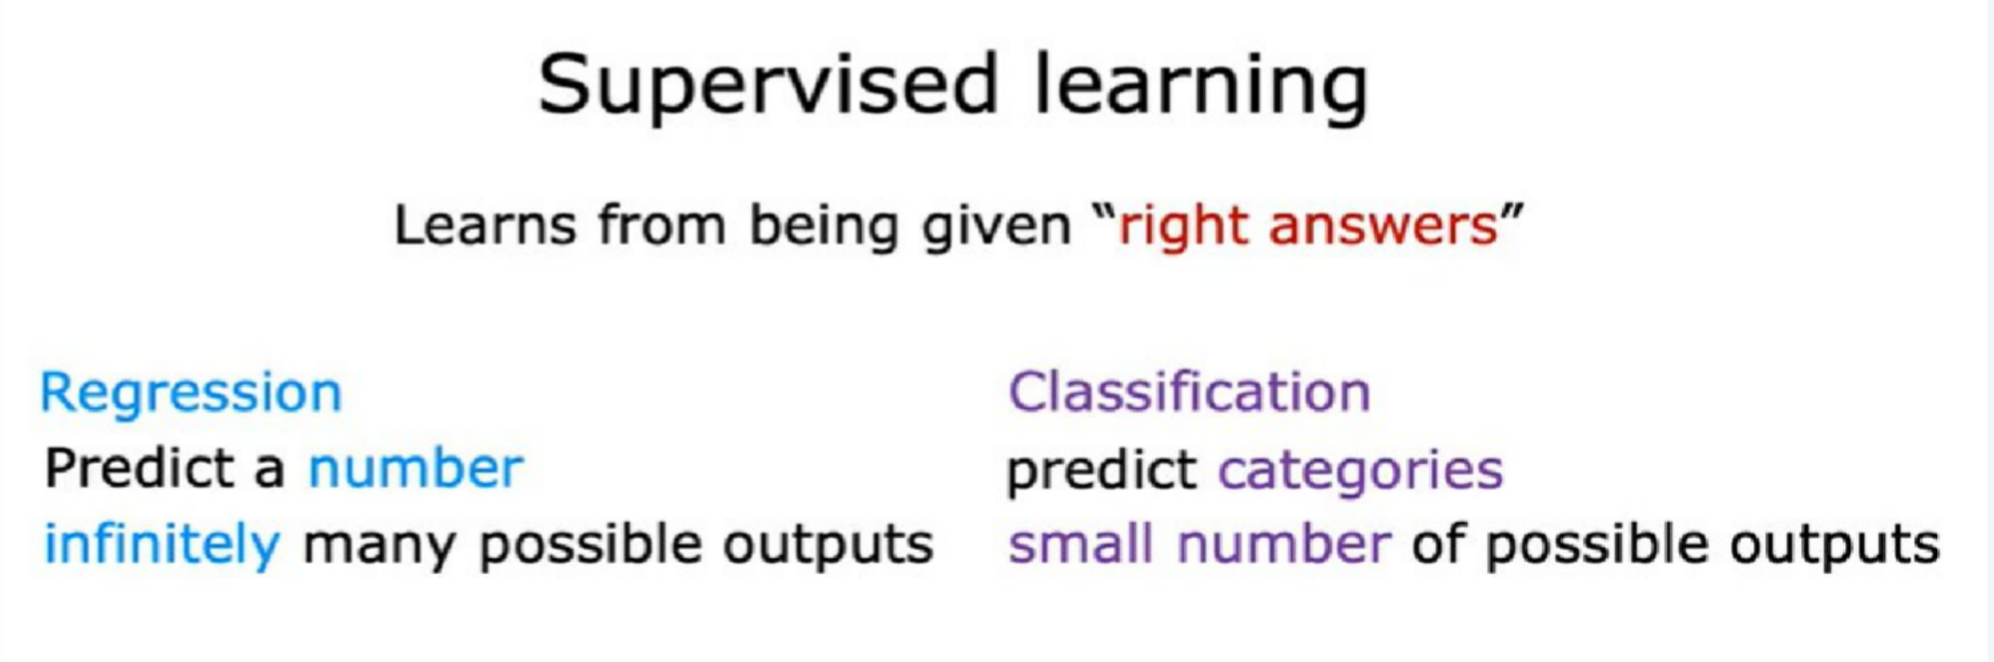

Slide 7
Unsupervised Learning
Were given data that isn't associated with any output labels y,say you're given data on patients and their tumor size and the patient's age.
But not whether the tumor was benign or malignant, so the dataset looks like this on the right. We're not asked to diagnose whether the tumor is benign or malignant, because we're not given any labels. our job is to find some structure or some pattern or just find something interesting in the data. This is unsupervised learning, we call it unsupervised because we're not trying to supervise the algorithm.
The training data contains only input features without any corresponding labels or target values.

Slide 8
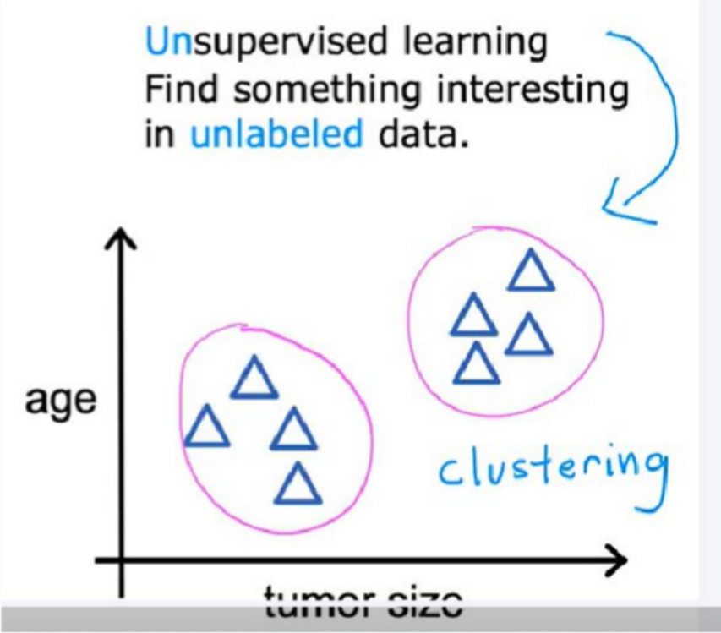
It's used for tasks like clustering (grouping similar data points), dimensionality reduction (reducing the number of features), and anomaly detection (finding unusual patterns).
For example, clustering is used in google news, what google news does is every day it goes. And looks at hundreds of thousands of news articles on the internet, and groups related stories together.

Slide 9
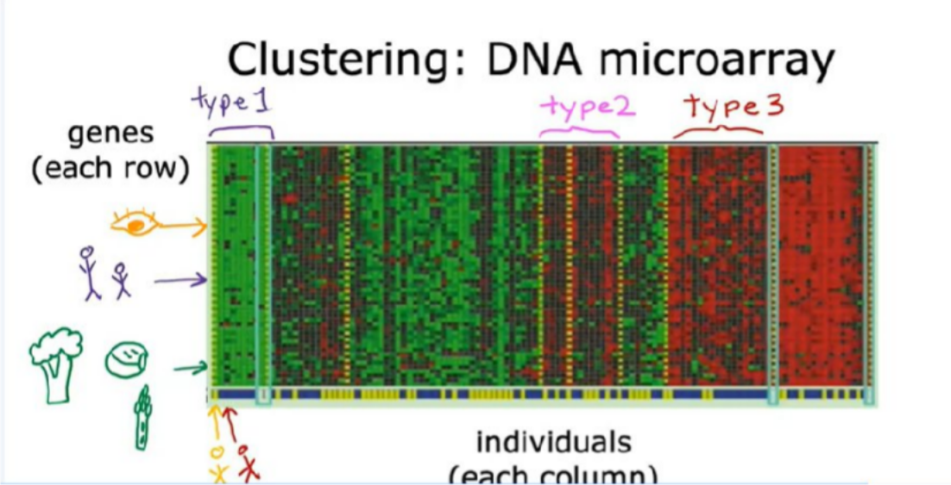
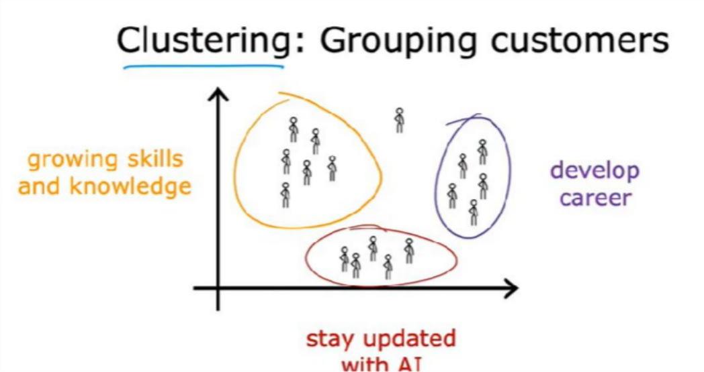
The idea is to measure how much certain genes, are expressed for each individual person.
So these colors red, green, gray, and so on, show the degree to which different individuals do, or do not have a specific gene active. And what you can do is then run a clustering algorithm to
group individuals into different categories. Or different types of people like maybe these individuals that group together.
That is market segmentation found a few distinct groups of individuals, one group's primary motivation is seeking knowledge to grow their skills. Perhaps this is you, and so that's great,
a second group's primary motivation is looking for a way to develop their career. Maybe you want to get a promotion or a new job, or make some career progression if this describes you, that's great too.
And yet another group wants to stay updated on how AI impacts their field of work, perhaps this is you, that's great too. This is a clustering that our team used to try to better serve our community
as we're trying to figure out

Slide 10
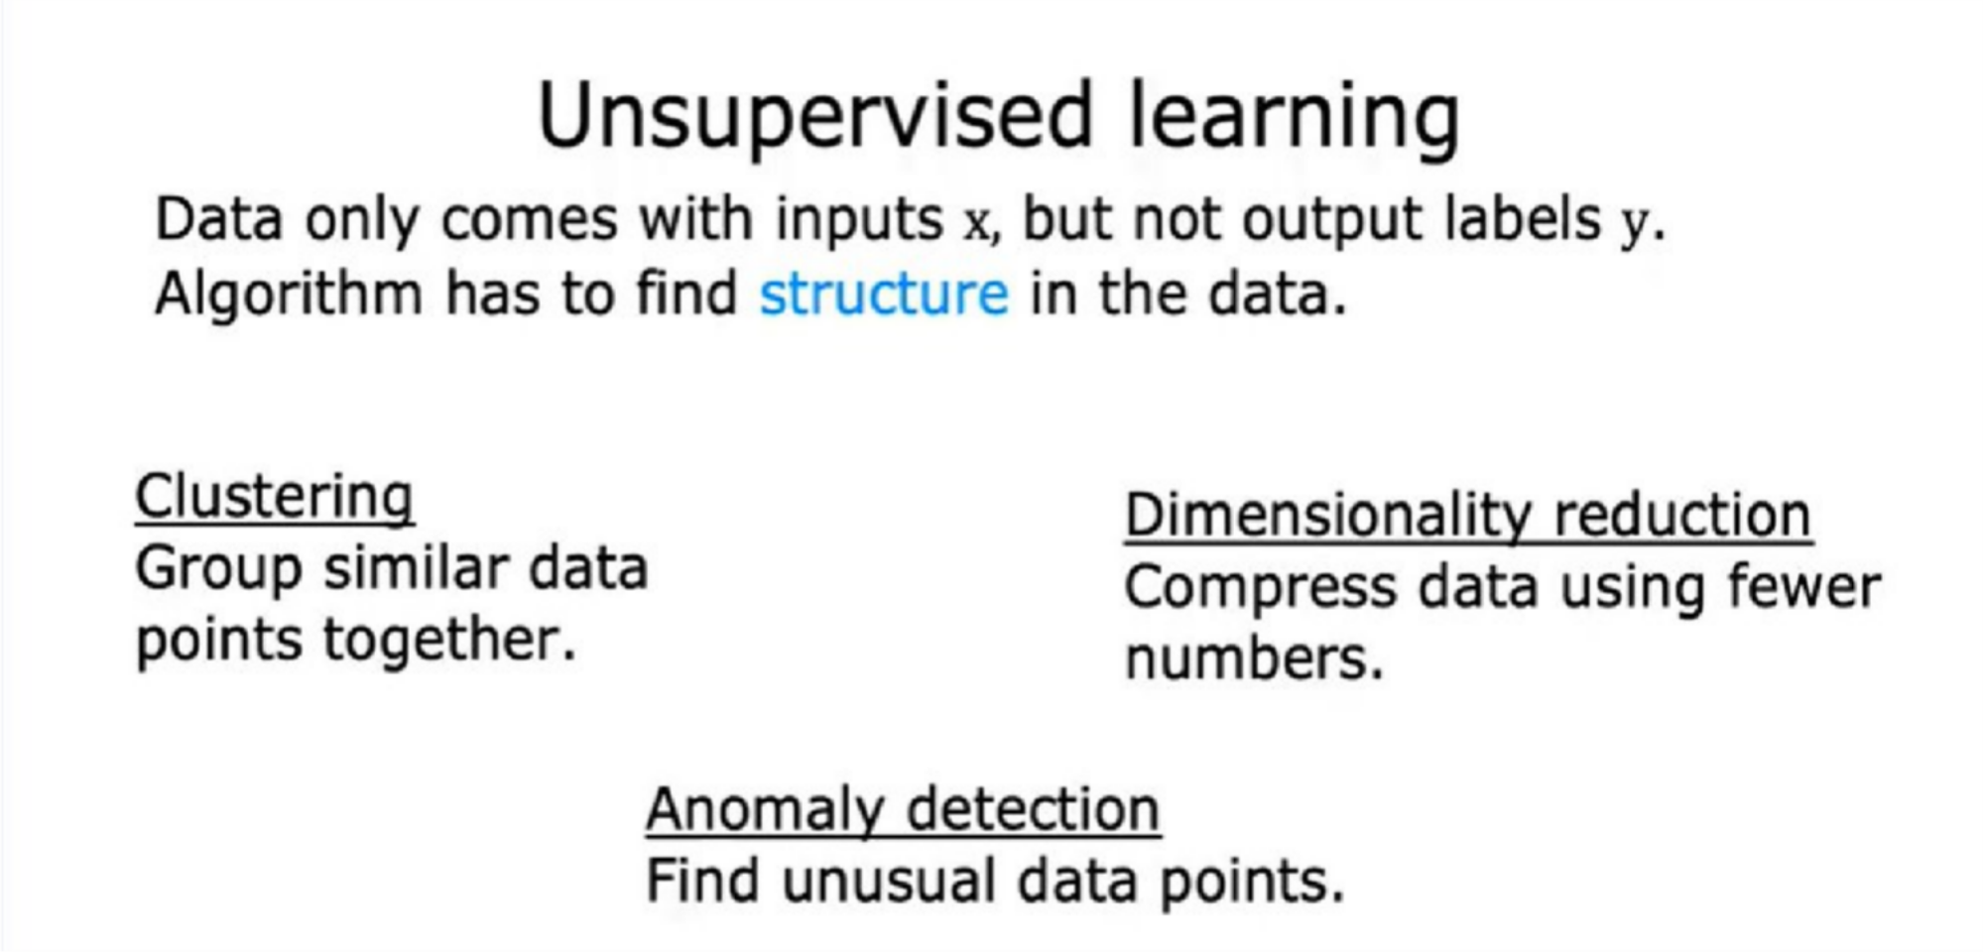

Slide 11
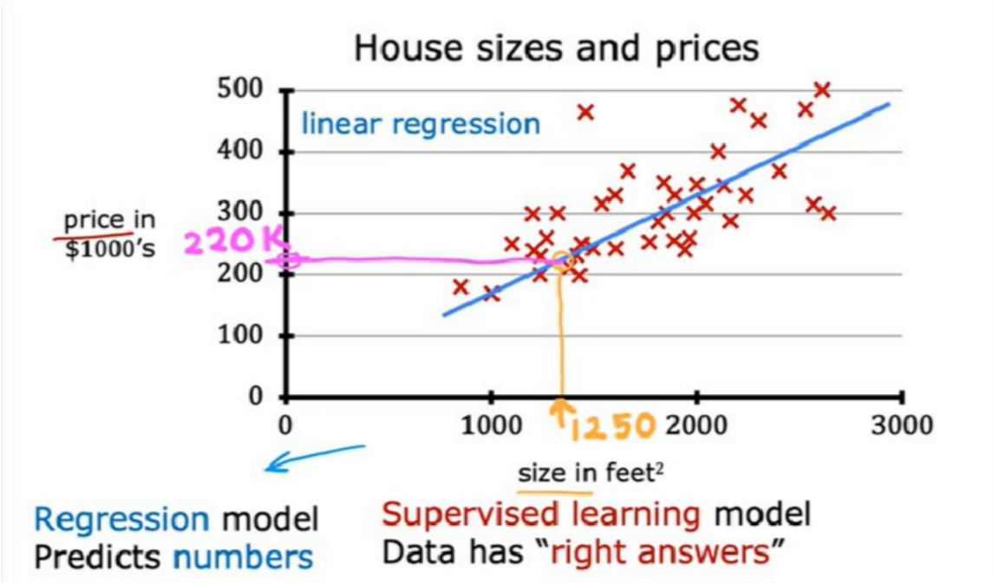
Regression
Linear Regression- Linear Regression Model that just means fitting a straight line to your data. It's probably the most widely used learning algorithm in the world today.
Example:House price prediction

Slide 12
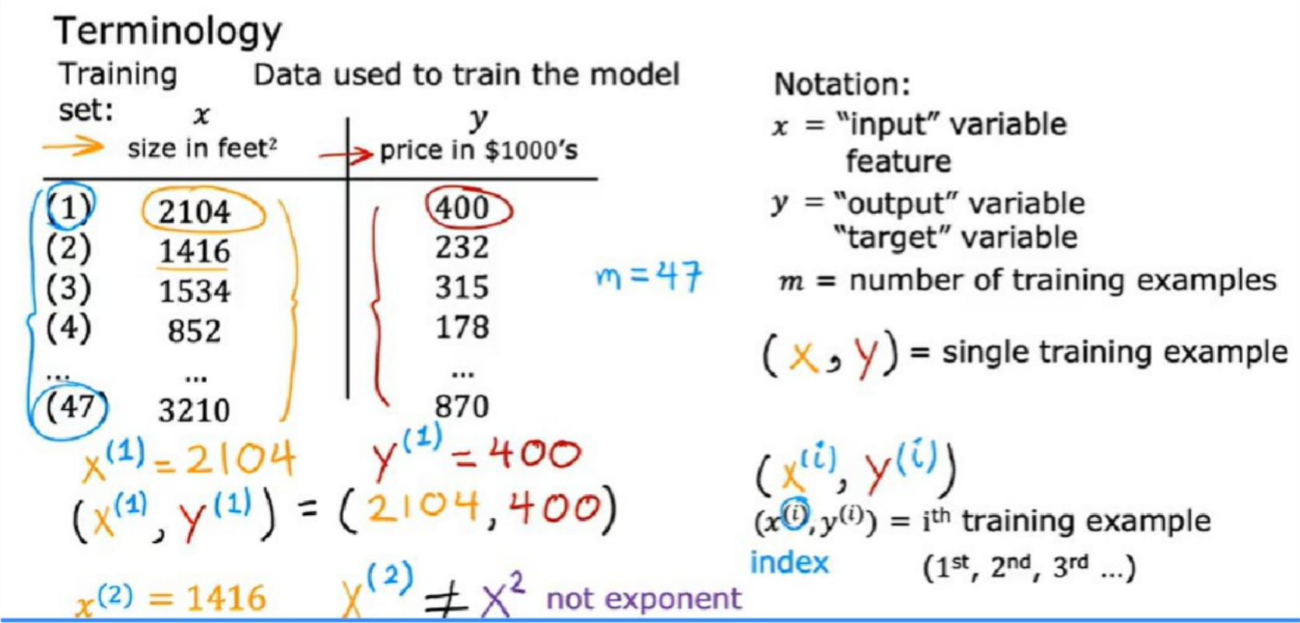

Slide 13
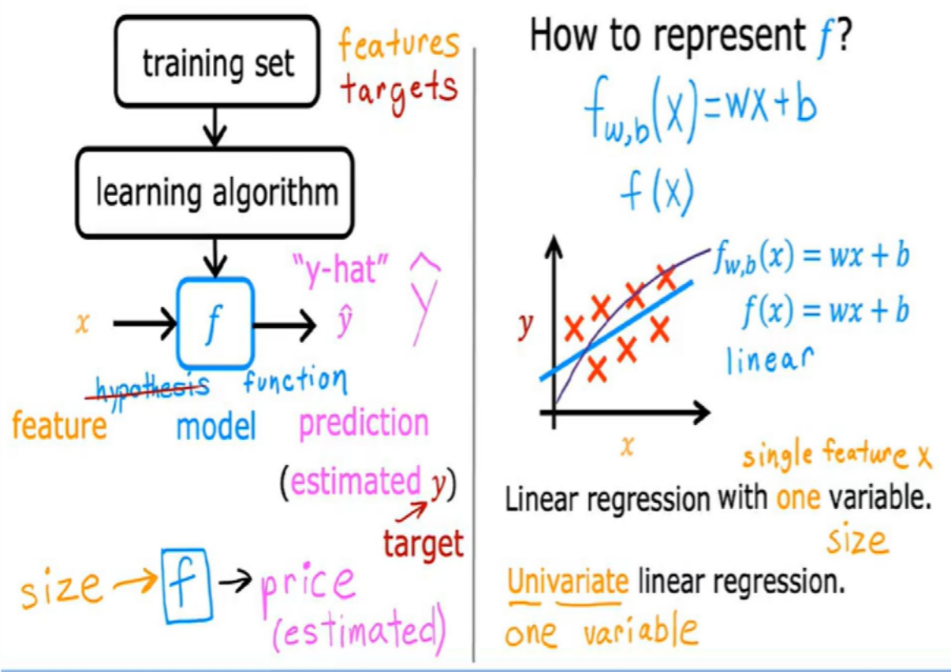
More specifically, this is linear regression with one variable, where the phrase one variable means that there's a single input variable or feature x, namely the size of the house.
Another name for a linear model with one input variable is univariate linear regression, where uni means one in Latin, and where variate means variable.
Univariate is just a fancy way of saying one variable.
In a later video, you'll also see a variation of regression where you'll want to make a prediction based not just on the size of a house, but on a bunch of other things that you may know about the house such as number of bedrooms and other features.
After this Refer to
C1_W1_Lab02_Model_Representation_Soln

Slide 14
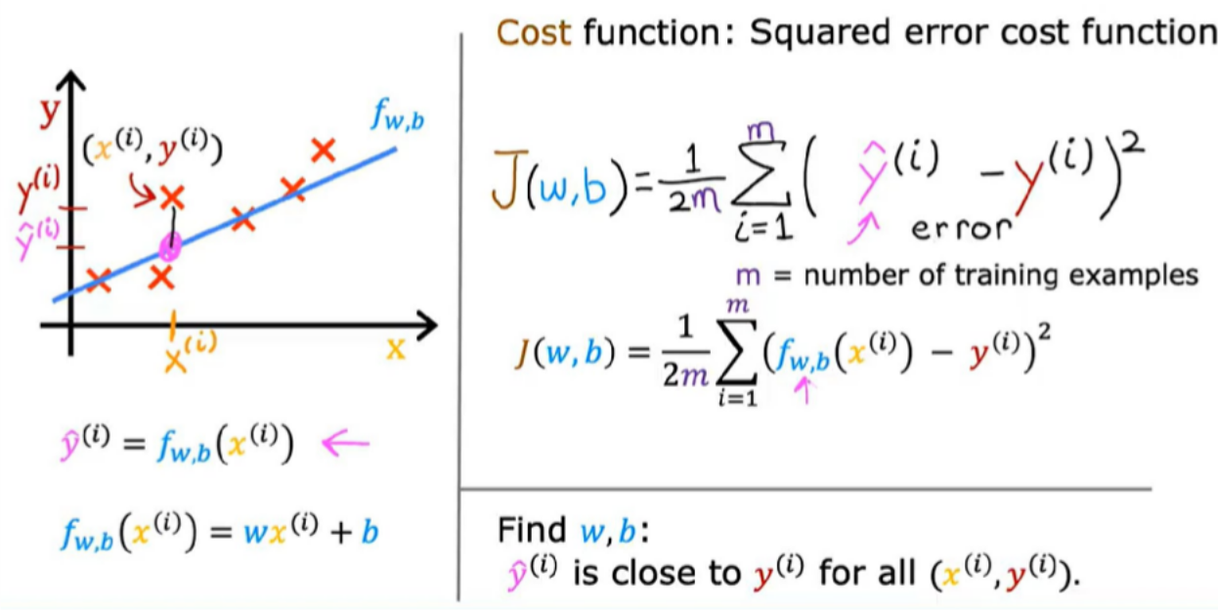
Cost Function
Cost function in linear regression measures how well the model’s predictions align with actual data. It measures the difference between predicted values and actual outcomes helping and guiding the model to minimize errors by adjusting its parameters and weights.

Slide 15
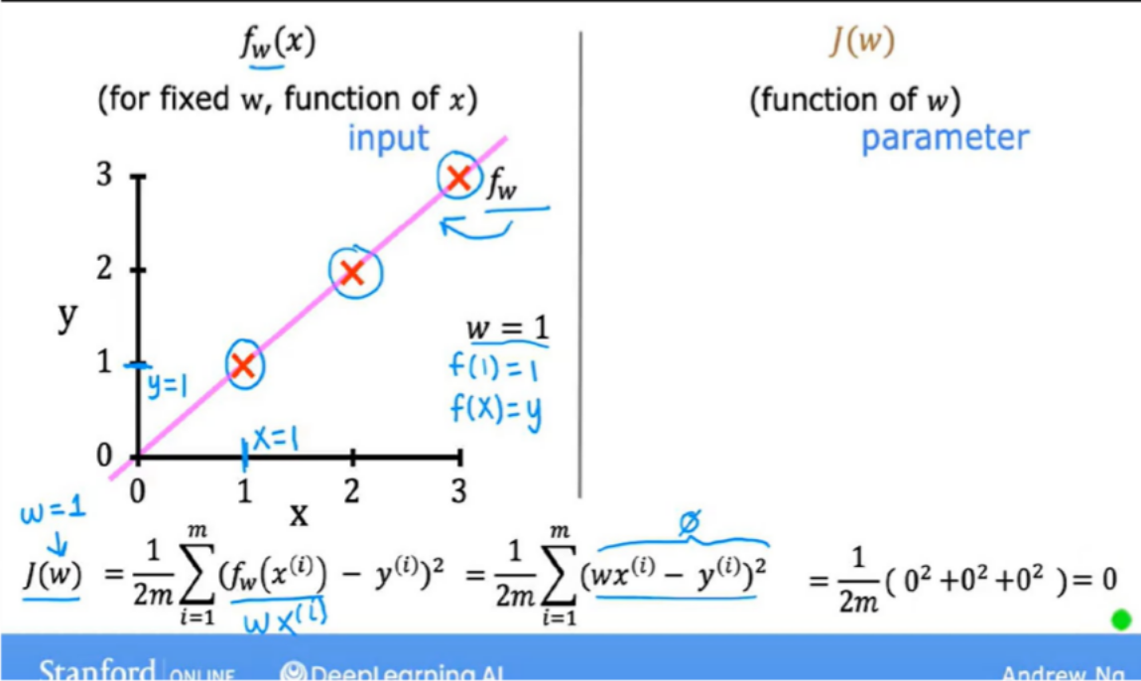
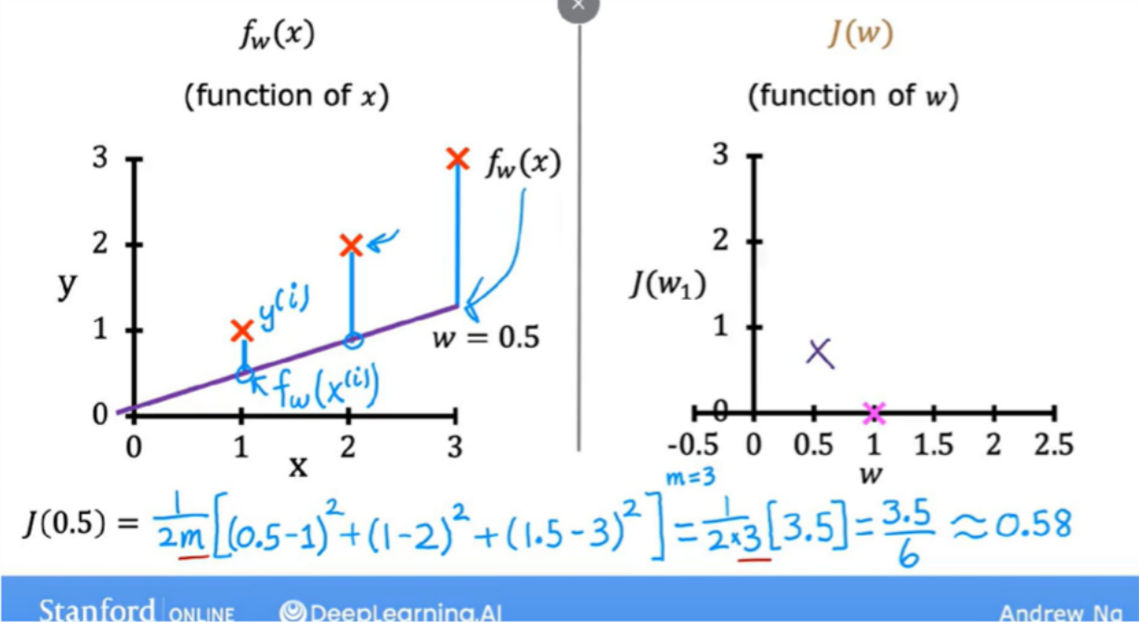
Here, the model's parameters are w, and b. Now, depending on the values chosen for these parameters, you get different straight lines like this. You want to find values for w, and b, so that the straight line fits the training data well.The below figures shows what are the different values obtained when the w value is different,so when w=1,we observed j(w)=0 in first figure,in the same way when w=0.5 j(w)=0.58 and so on.here b=0

Slide 16
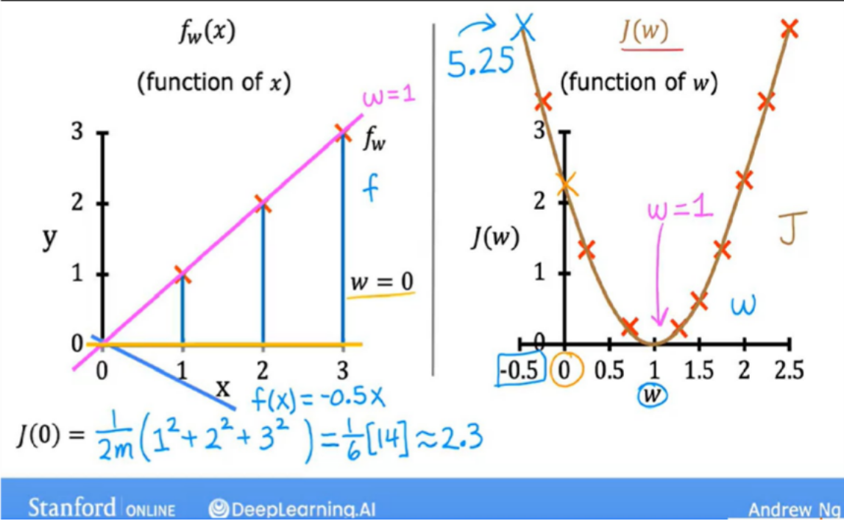
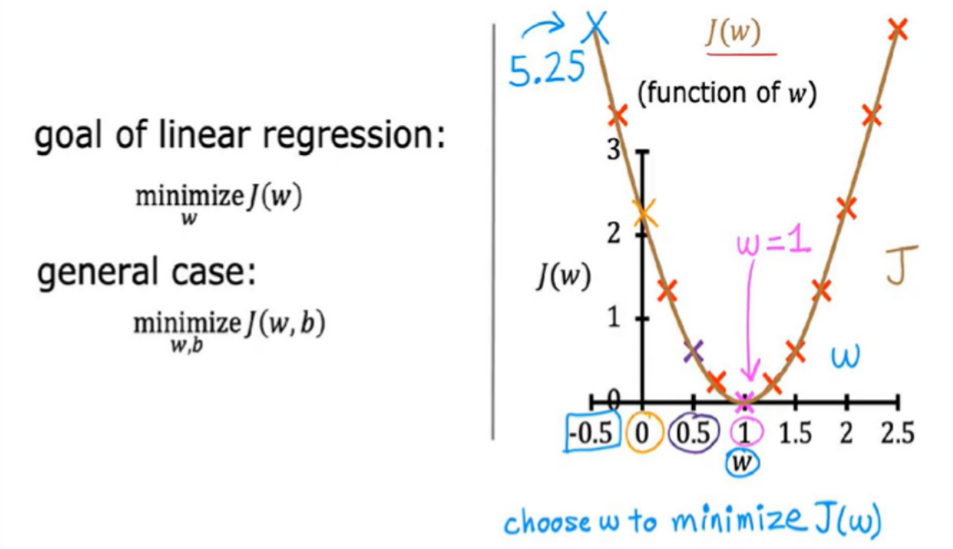
Kjhg
The goal of linear regression is to find the parameters w or w and b that results in the smallest possible
value for the cost function J.

Slide 17
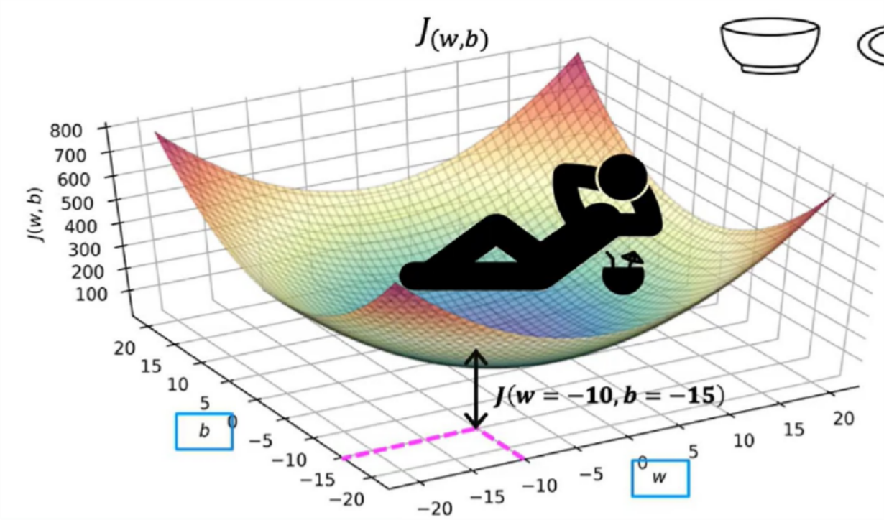
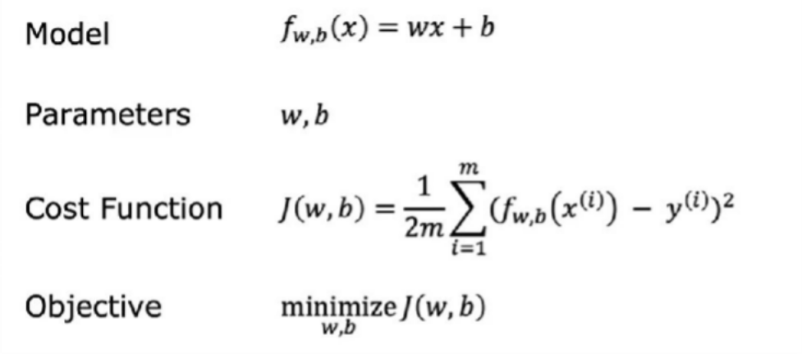
In previous ,b was set to 0,now if we consider b also then it looks like below.
After this Refer to C1_W1_Lab03_Cost_function_Soln

Slide 18
Gradient Descent Algorithm
Now in linear regression, rather than having to manually try to read a contour plot for the best value for w and b, which isn't really a good procedure and also won't work once we get to more complex machine learning models. What you really want is
an efficient algorithm that you can write in code for automatically finding the values of parameters w and b they give you the best fit line. That minimizes the cost function j.
There is an algorithm for doing this called gradient descent.

Slide 19
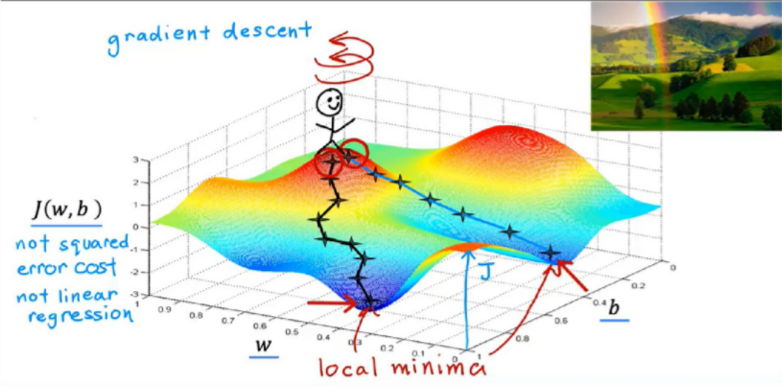
Gradient descent is an iterative optimization algorithm used in machine learning to find the minimum of a function. It works by repeatedly adjusting the parameters of a model based on the direction of the steepest descent of the cost function, essentially "walking downhill" to find the lowest point.

Slide 20
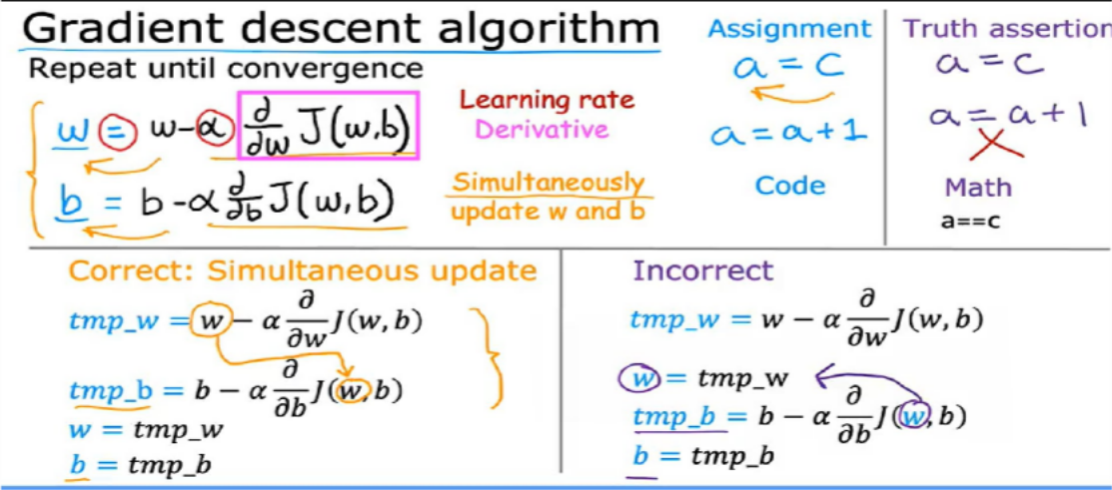
Gradient descent Algorithm working
The symbol here is the Greek alphabet Alpha in this equation, Alpha is also called the learning rate. The learning rate is usually a small positive number between 0 and 1 and
it might be say, 0.01. What Alpha does is, it basically controls how big of a step you take downhill. If Alpha is very large, then that corresponds to a very aggressive gradient descent procedure where you're trying to take huge steps downhill. If Alpha is very small, then you'd be taking small baby steps downhill. Then the derivative term that I drew a magenta box around as telling you in which direction you want to take your baby step. In combination with the learning rate Alpha, it also determines the size of the steps you want to take downhill.

Slide 21
You also have an assignment operations update the parameter b that looks very
similar. b is assigned the old value of b minus the learning rate Alpha times this slightly different derivative term, d/db of J of wb. Remember in the graph of the surface plot where you're taking baby steps until you get to the bottom of the value, well, for the gradient descent algorithm, you're going to repeat these two update steps until the algorithm converges. By converges, I mean that you reach the point at a local minimum where the parameters w and b no longer change much with each additional step that you take. Now, there's one more subtle detail about how to correctly in semantic gradient descent, you're going to update two parameters, w and b. This update takes place for both parameters, w and b. One important detail is that for gradient descent,
you want to simultaneously update w and b, meaning you want to update both parameters at the same time. What I mean by that, is that in this expression, you're going to update w from the old w to a new w, and you're also updating b from its oldest value to a new value of b. The way to implement this is to compute the right side, computing this thing for w
and
b, and simultaneously at the same time, update w and b to the new values.

Slide 22
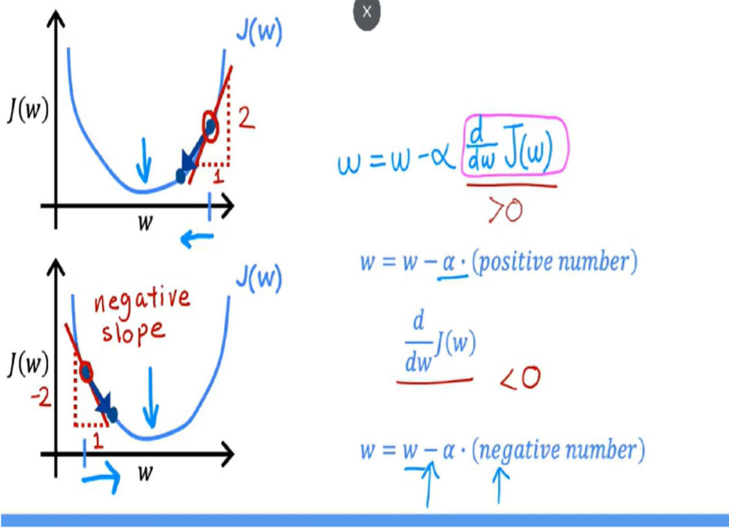
Working of gradient descent
If the point is at right side of the curve,then the derivative of that is positive number,so when we subtract that +ve number from w then the w value is decreased,which means it is coming towards the minimum.
If the point is at left side of the curve,then the derivative of that is negative number,so when we subtract that -ve number(ideally adding because -*-=+) from w then the w value is increases,which means it is coming towards the minimum.

Slide 23
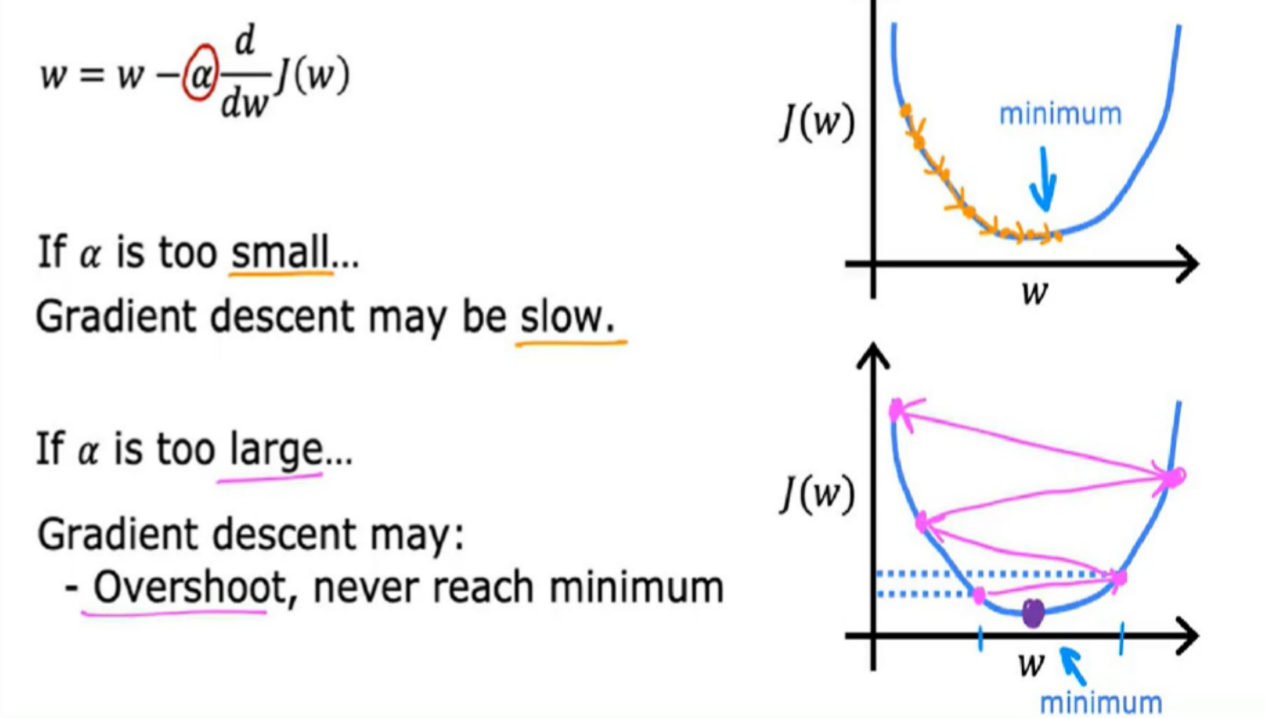
The choice of the learning rate, alpha will have a huge impact on the efficiency of your implementation of gradient descent. And if alpha, the learning rate is chosen poorly rate of descent may not even work at all.

Slide 24
if the learning rate is too small, then gradient descents will work, but it will be slow. It will take a very long time because it's
going to take these tiny tiny baby steps. And it’s going to need a lot of steps before it gets anywhere close to the minimum.
let's say we start grating descent with W at this value here. So it's actually already pretty close to the minimum. So the
decorative points to the right. But if the learning rate is too large then you update W very giant step to be all the way over here. And that’s this point here on the function J. So you move from this point on the left, all the way to this point on the right. And now the cost has actually gotten worse. It has increased because it started out at this value here and after one step, it actually increased to this value here. Now the derivative at this new point says to decrease W but when the learning rate is too big. Then you may take a huge step going from here all the way out here. So now you've gotten to this point here and again, if the learning rate is too big. Then you take another huge step with an acceleration and way overshoot the minimum again. So now you're at this point on the right and one more time you do another update. And end up all the way here and so you're now at this point here. So as you may notice you're actually getting further and further away from the minimum. So if the learning rate is too large, then creating the sense may overshoot and may never reach the minimum. And another way to say that is that great intersect may fail to converge and may even diverge.

Slide 25
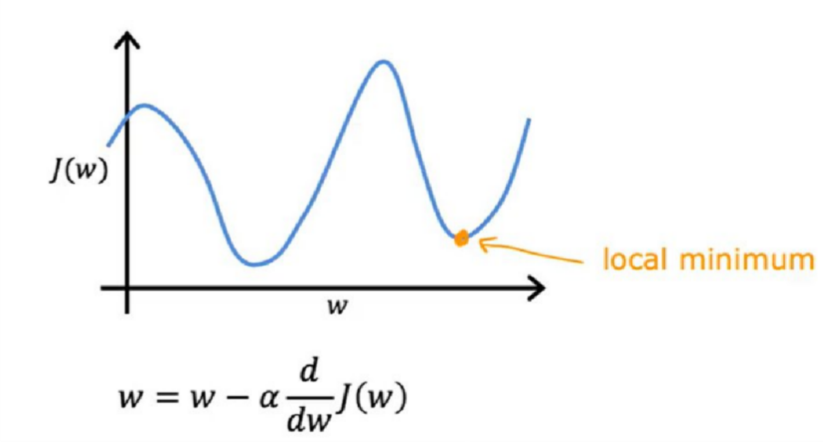
So, here's another question, you may be wondering one of your parameter W is already at this point here. So that your cost J is already at a local minimum. What do you think? One step of gradient descent will do if you've already reached a minimum?

Slide 26
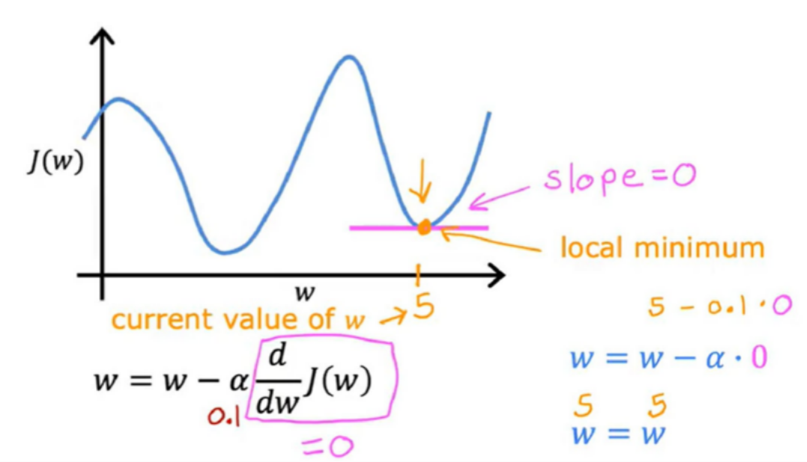
The function shown here isn't a square error cost function, and this cost function has two local minima corresponding to the two valleys visible in the graph.Now, let's suppose that after some number of steps of gradient descent, your parameter W is at a value of, say, 5. So, this is the current value of W.This means you're at this point on the cost function J, which happens to be a local minimum.It turns out that if you draw the tangent to the function at this point, the slope of this line is zero.Thus, the derivative term here is equal to zero for the current value of W. Therefore, your gradient descent update becomes:
W = W − α × 0
Here, α is the learning rate, and the derivative term is zero. So this is the same as saying:
W = W
This means that if you're already at a local minimum, gradient descent leaves W unchanged,
because it just updates the new value of W to be the exact same as the old value of W.

Slide 27
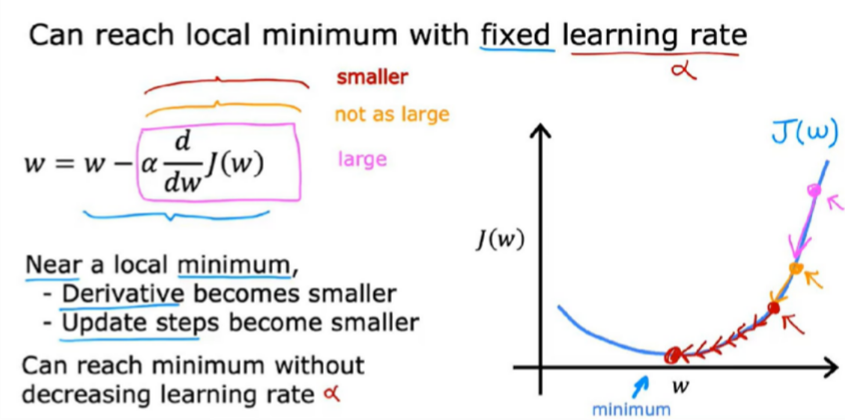
Gradient descent can reach a local minimum, even with a fixed learning rate alpha?
Zfgh

Slide 28
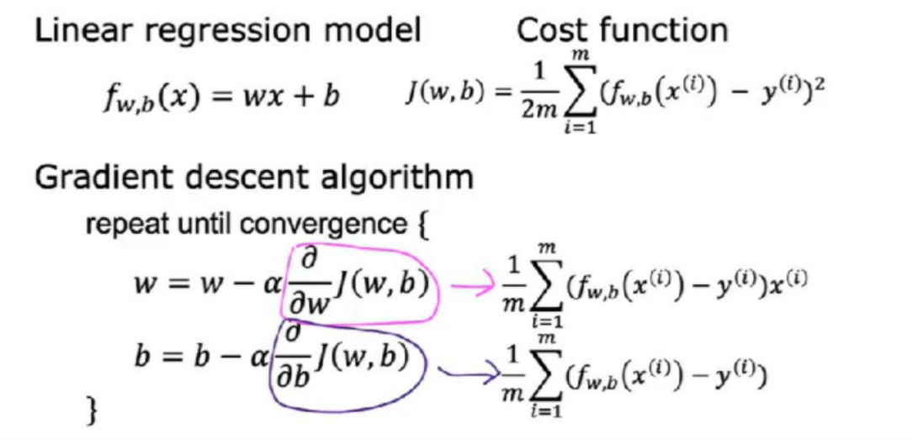
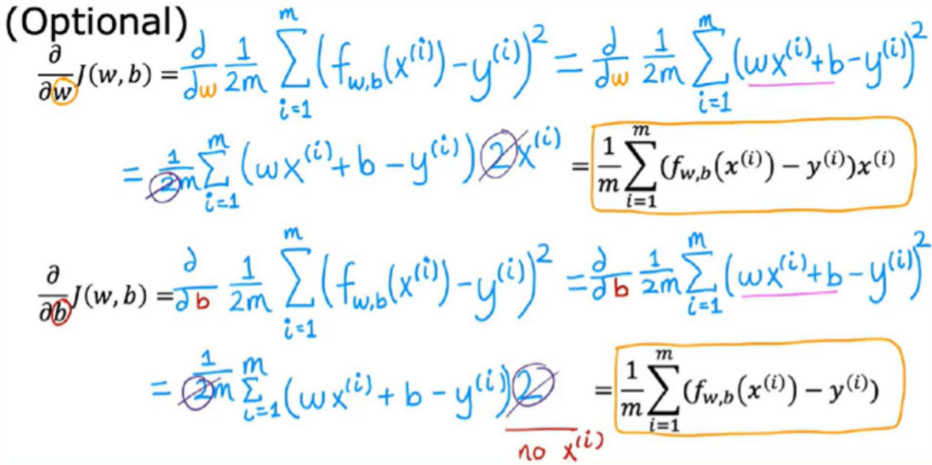
Gradient Descent for Linear Regression
Kjh
Refer to C1_W1_Lab04_Gradient_Descent_ Soln

Slide 29
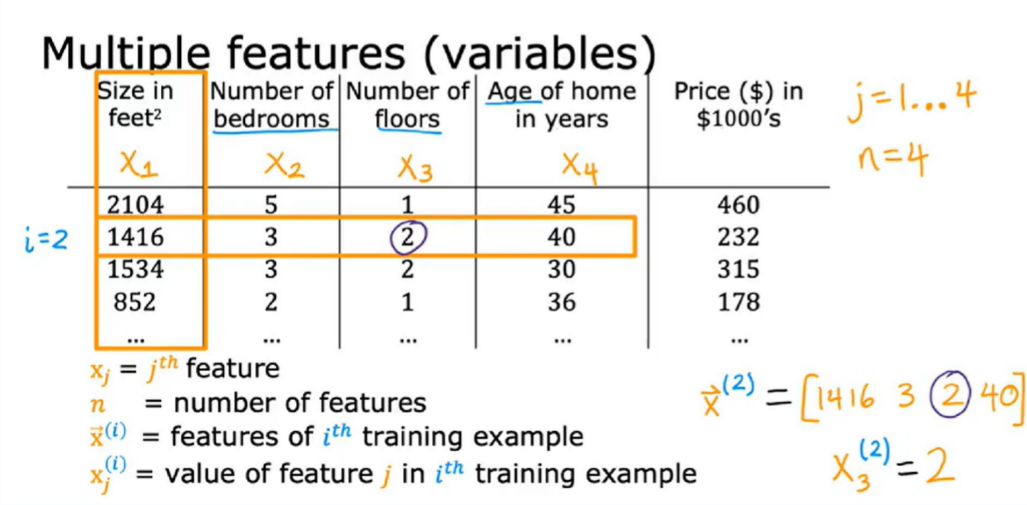
Linear Regression with multiple variables

Slide 30
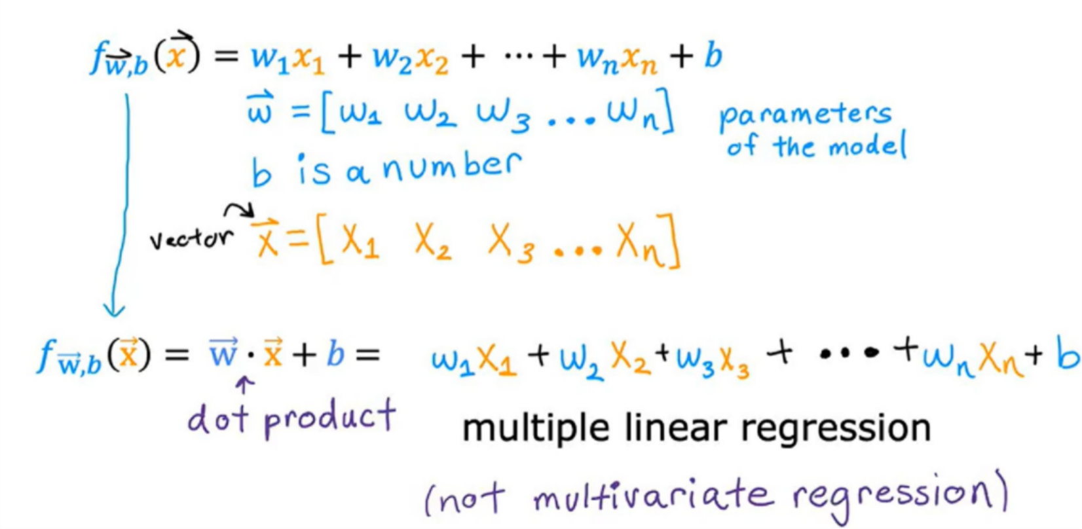
Formula:

Slide 31
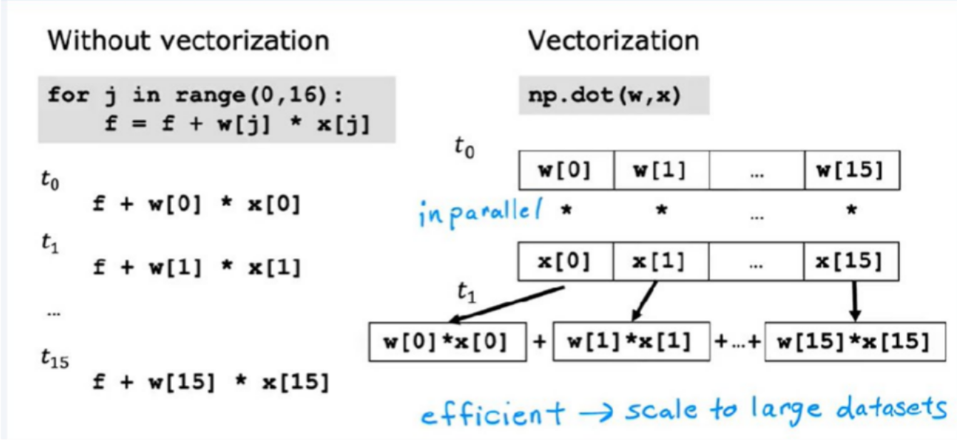
Vectorization
This means that codes with vectorization can perform calculations in much less time than codes without vectorization. This matters more when you're running algorithms on large data sets or trying to train large models, which is often the case with machine learning. That's why being able to vectorize implementations of learning algorithms, has been a key step to getting learning algorithms to run efficiently, and therefore scale well to large datasets that many modern machine learning algorithms now have to operate on.
vectorization makes your code shorter, so hopefully easier to write and easier for you or others to read, and it also makes it run much faster.

Slide 32
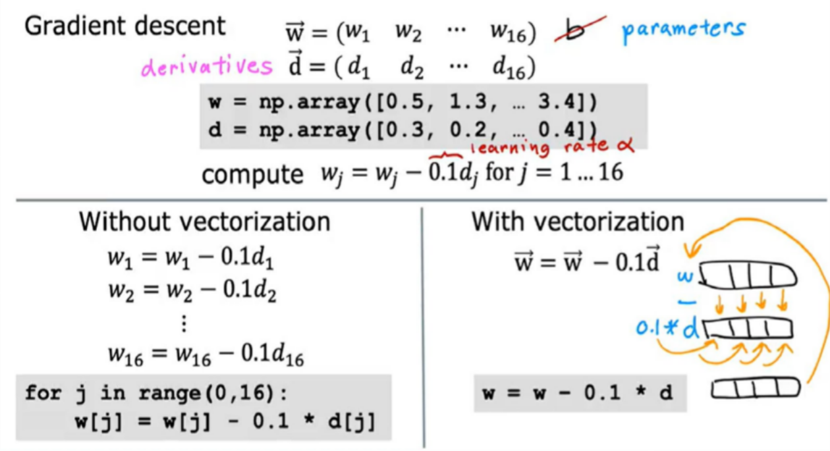
Behind the scenes, the computer takes the NumPy arrays w and d and uses parallel processing hardware to efficiently perform all 16 computations at once. This is the power of a vectorized implementation, which leads to a much more efficient execution of linear regression. While the speed improvement may not be dramatic with only 16 features, the impact becomes significant when dealing with thousands of features and large training datasets. In such cases, vectorization can drastically reduce the running time of your learning algorithm, potentially turning a process that would take many hours into one that finishes in just a minute or two.
Refer to C1_W2_Lab01_Python_Numpy_Vectorization_Soln

Slide 33
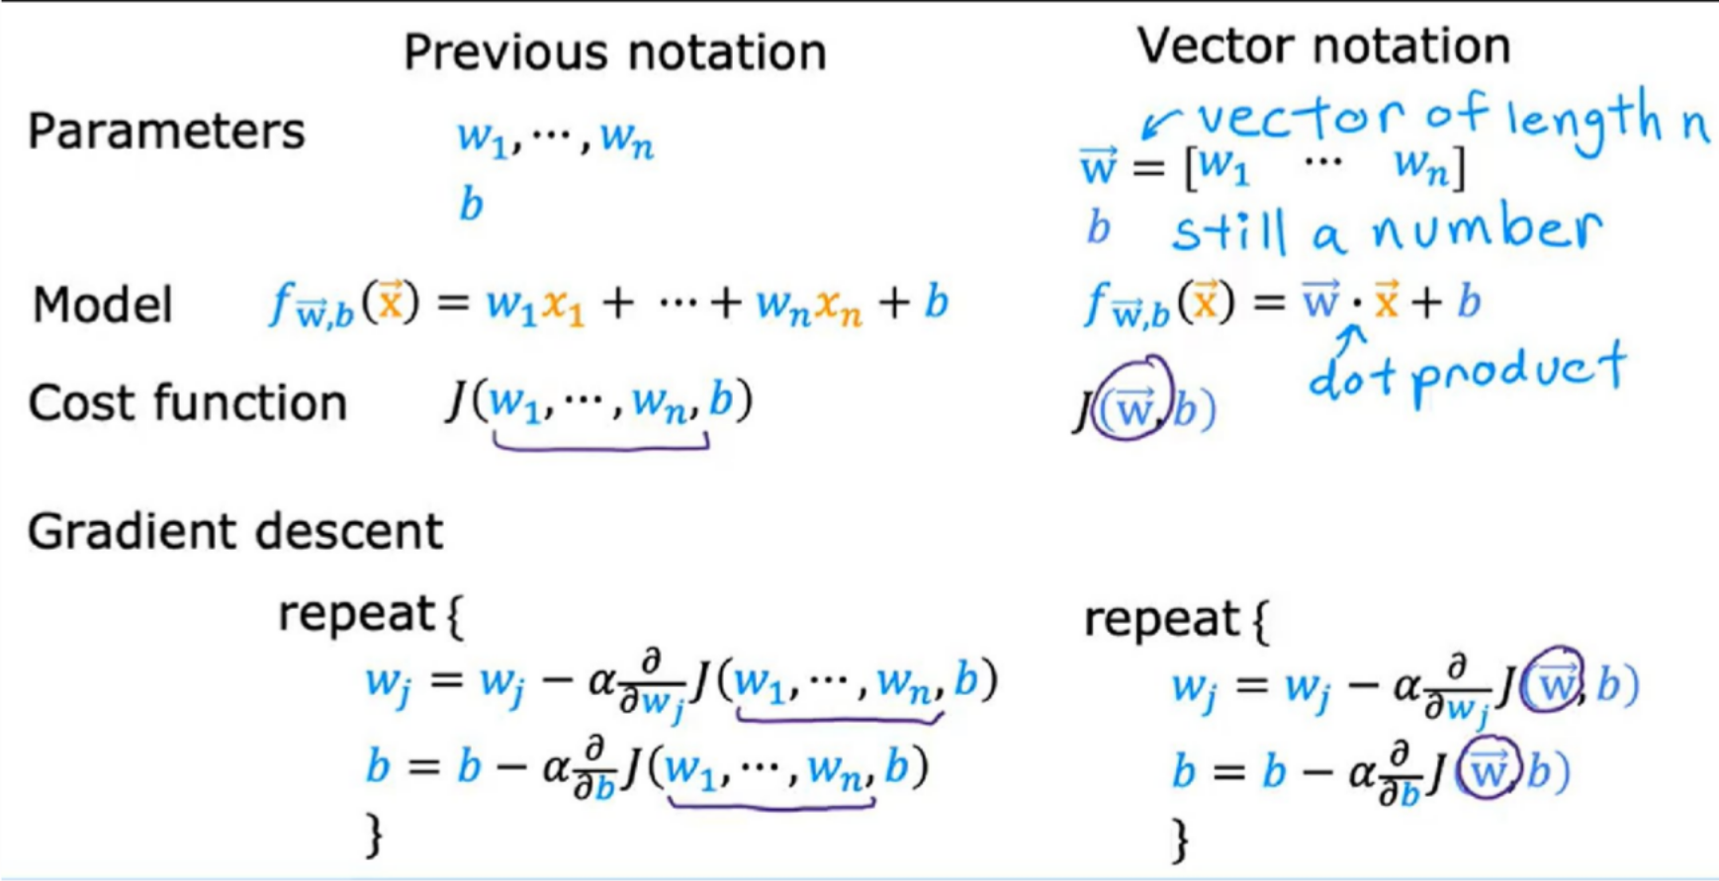
Gradient descent for multiple linear regression

Slide 34
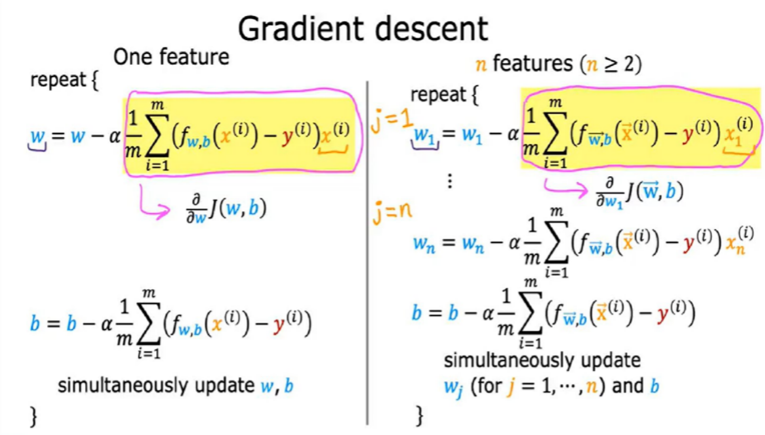
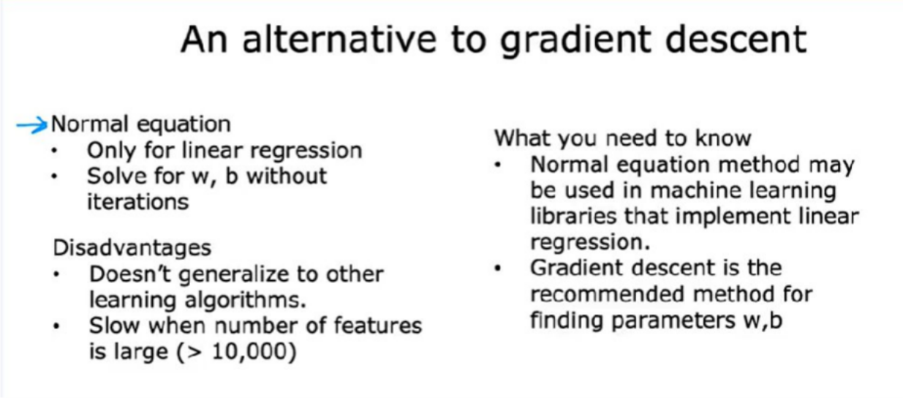
Refer to C1_W2_Lab02_Multiple_Variable_Soln

Slide 35
Feature Scaling
It helps to normalize the data within a particular range. If feature scaling is not done then machine learning algorithm tends to use greater values as higher and consider
smaller values as lower regardless of the unit of the values. For example it will take 10 m and 10 cm both as same regardless of their unit. In this article we will learn about different techniques which are used to perform feature scaling.
when you have different features that take on very different ranges of values, it can cause gradient descent to run slowly but re scaling the different features so they all take on comparable range of values.

Slide 36
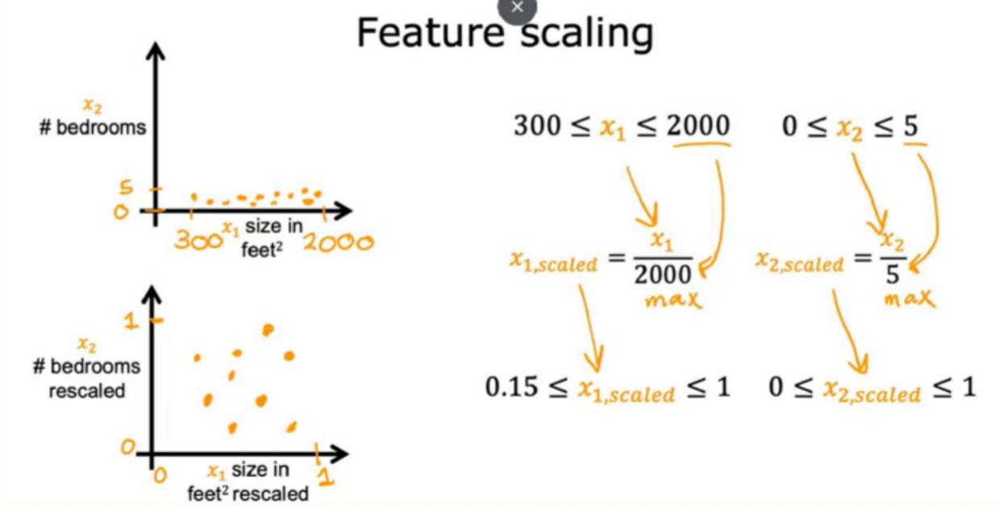
This is one of the method to standardize the data i.e dividing it by maximum

Slide 37
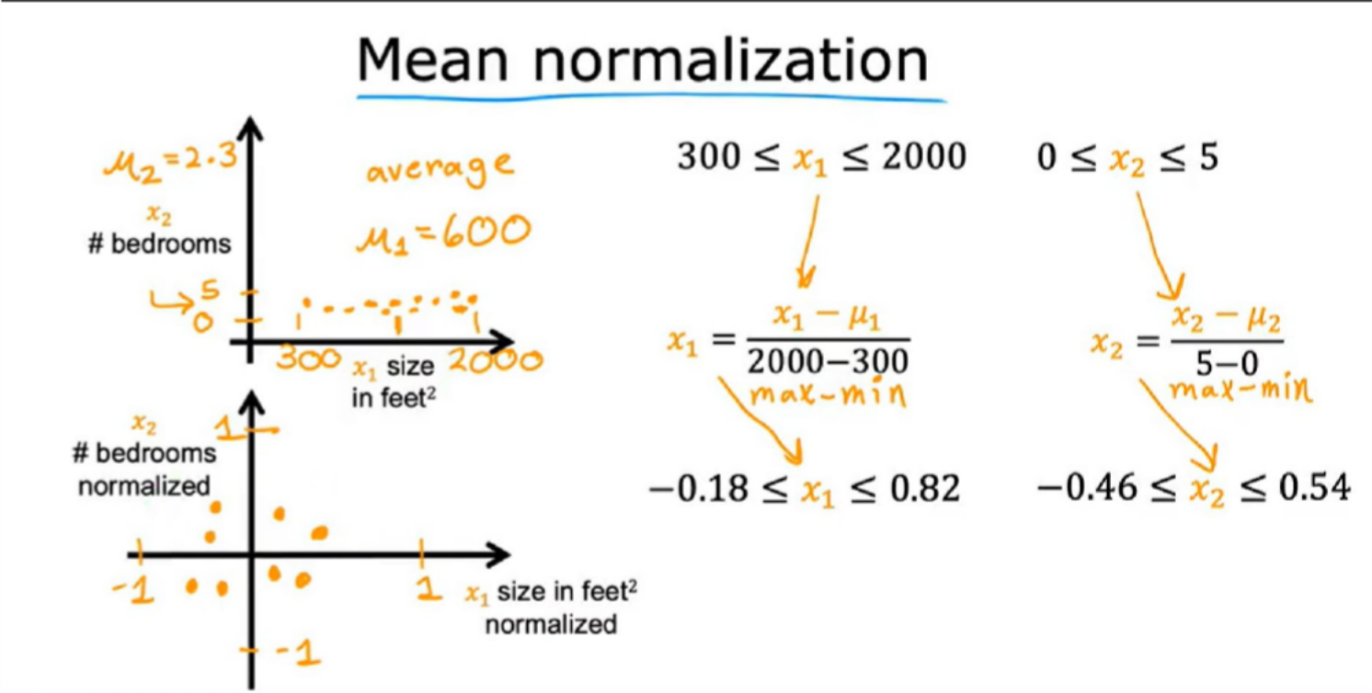
Mean Normalization-It is another method for scaling the data/features.
you start with the original features and then you re-scale them so that both of them are centered around zero. Whereas before they only had values greater than zero, now they have both negative and positive values that may be usually between negative one and plus one. To calculate the mean normalization of x_1, first find the average

Slide 38
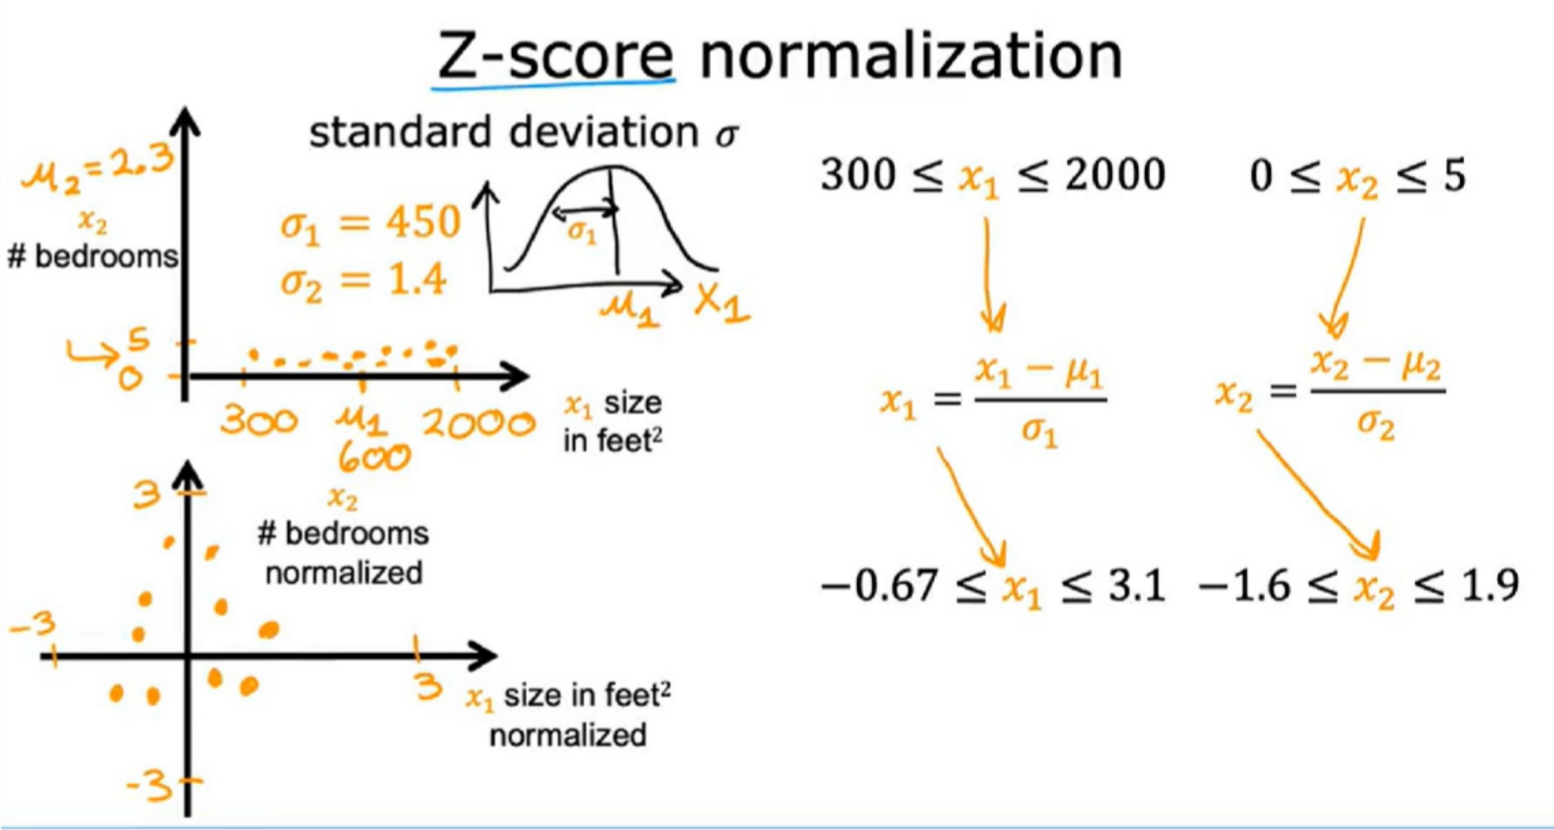
Z-score Normalization-It is also another method for scaling the data/features.

Slide 39
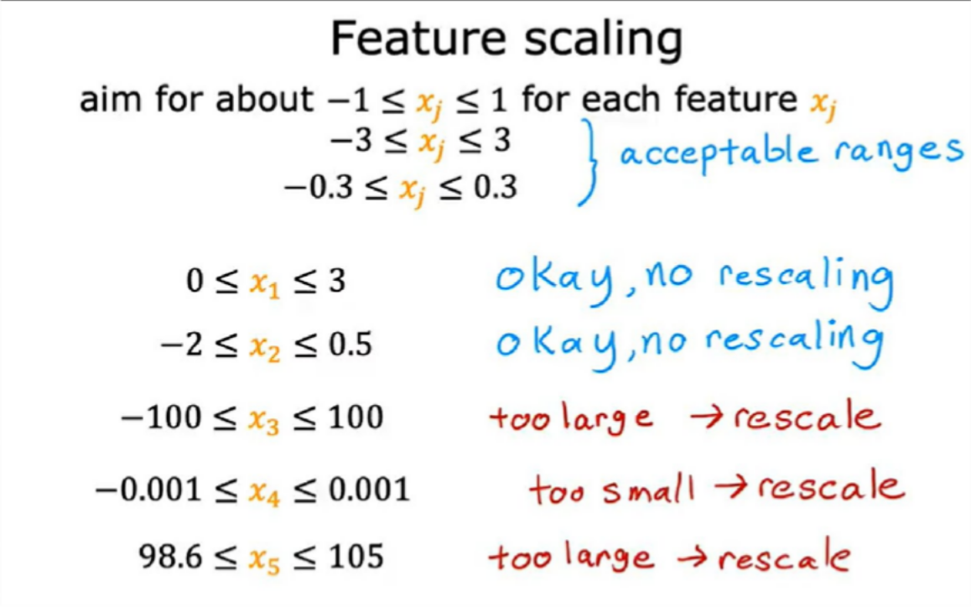

Slide 40


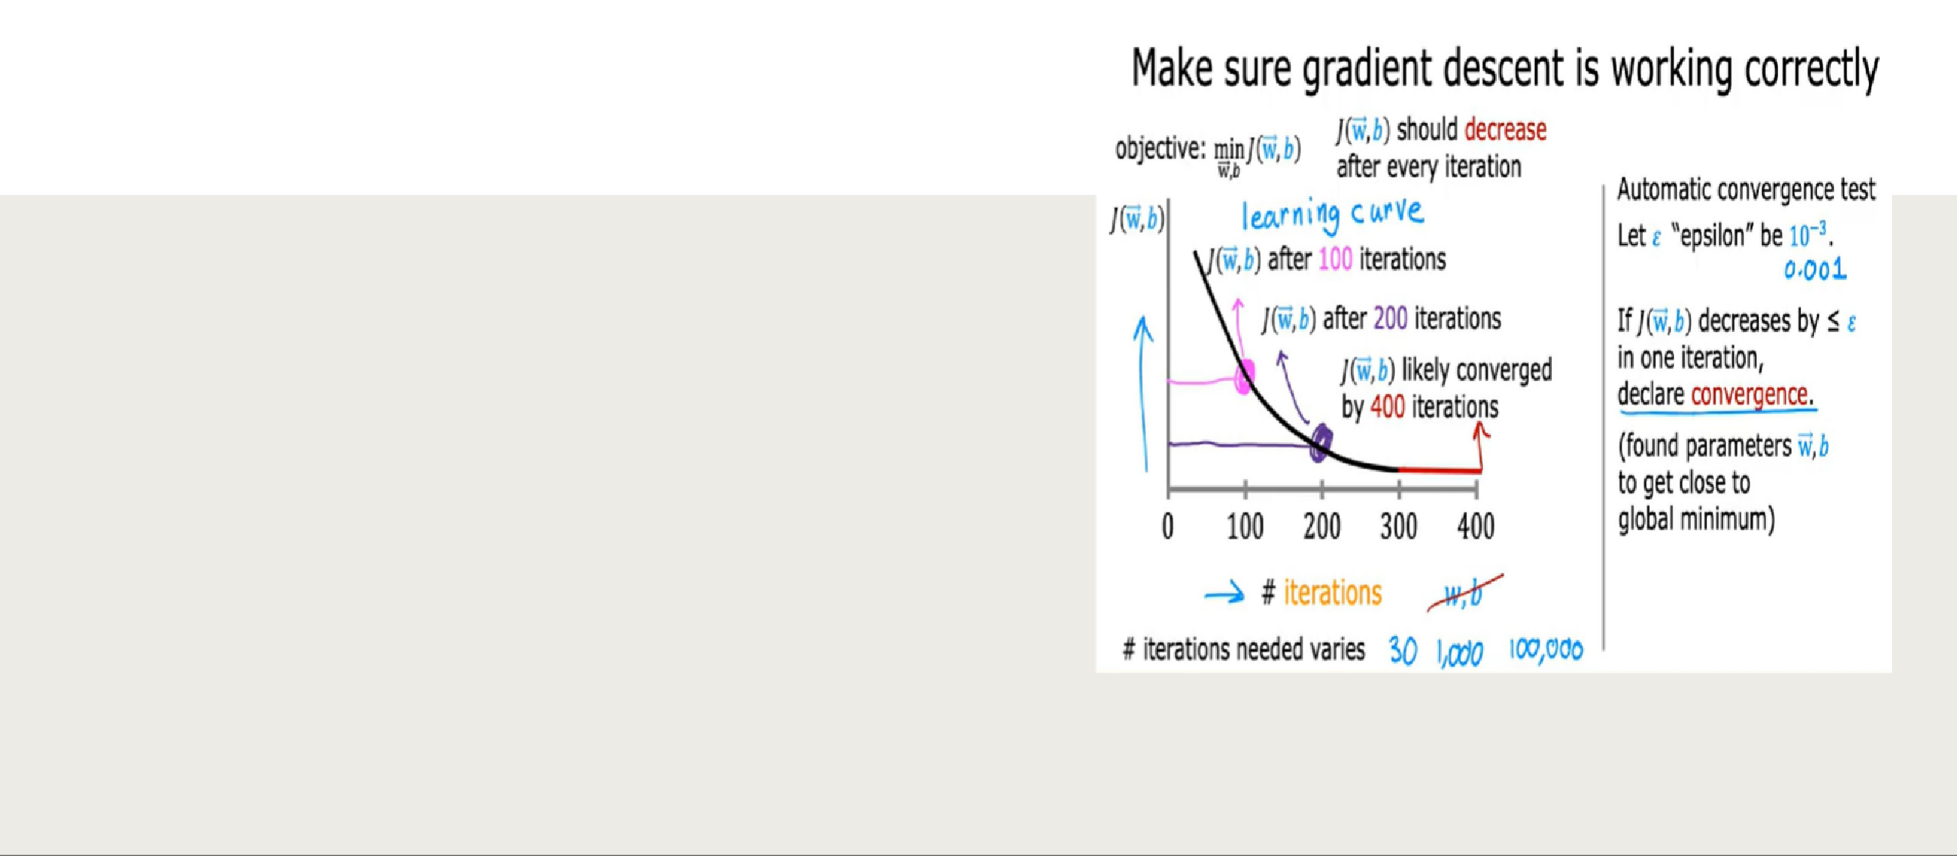

How to check the gradient descent is working well i.e is it finding the global minimum or something close to it?
Looking at this graph helps you to see how your cost J changes after each iteration of gradient descent. If gradient descent is working properly, then the cost J should decrease after every single iteration. If J ever increases after one iteration, that means either Alpha is chosen poorly, and it usually means Alpha is too large, or there could be a bug in the code. Another useful thing that this part can tell you is that if you look at this curve, by the time you reach maybe 300 iterations also, the cost J is leveling off and is no longer decreasing much. By 400 iterations, it looks like the curve has flattened out. This means that gradient descent has more or less converged because the curve is no longer decreasing.

Slide 41
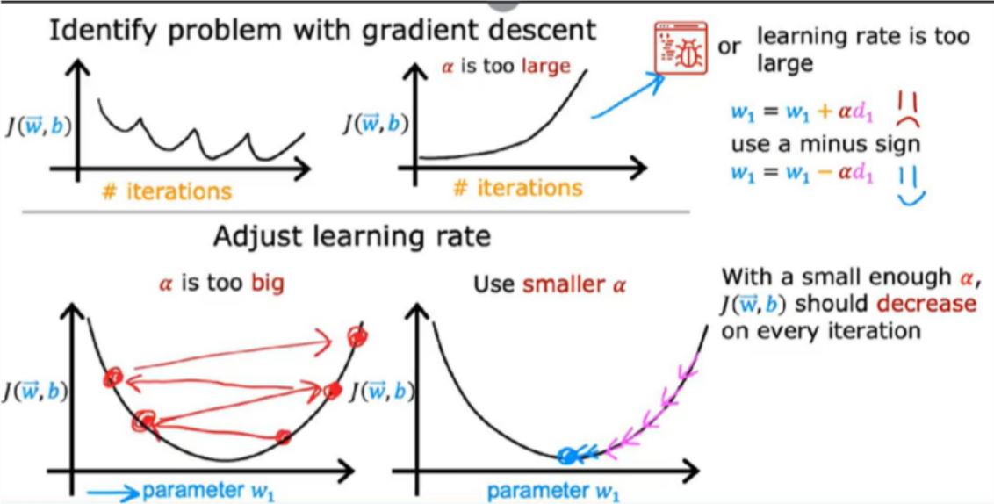
Choosing the Learning Rate
So if gradient descent isn't working, one thing I often do and I hope you find this tip useful too, one thing I'll often do is just set Alpha to be a very small number and see if that causes the cost to decrease on every iteration. If even with Alpha set to a very small number, J doesn't decrease on every single iteration, but instead sometimes increases, then that usually means there's a bug somewhere in the code. So when I am running gradient descent, I will usually try a range of values for the learning rate Alpha. I may start by trying a learning rate of 0.001 and I may also try learning rate as 10 times as large say 0.01 and
0.1 and so on.

Slide 42
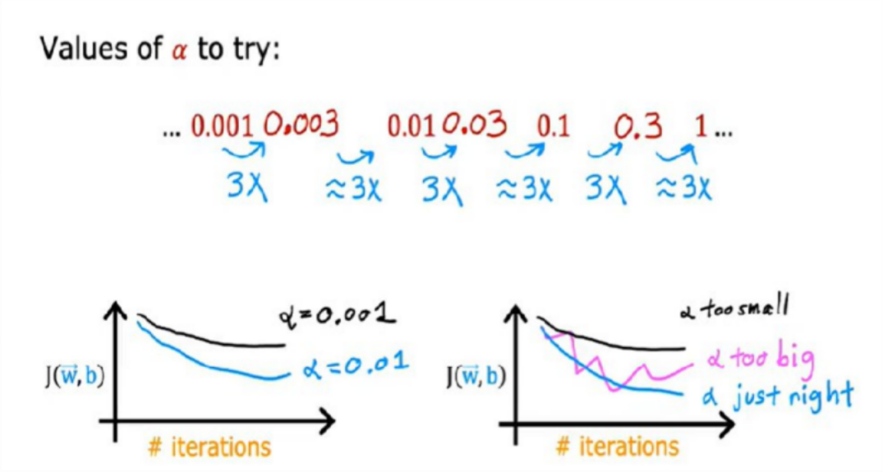
After this refer C1_W2_Lab03_Feature_Scaling_and_Learning_Rate_Soln

Slide 43
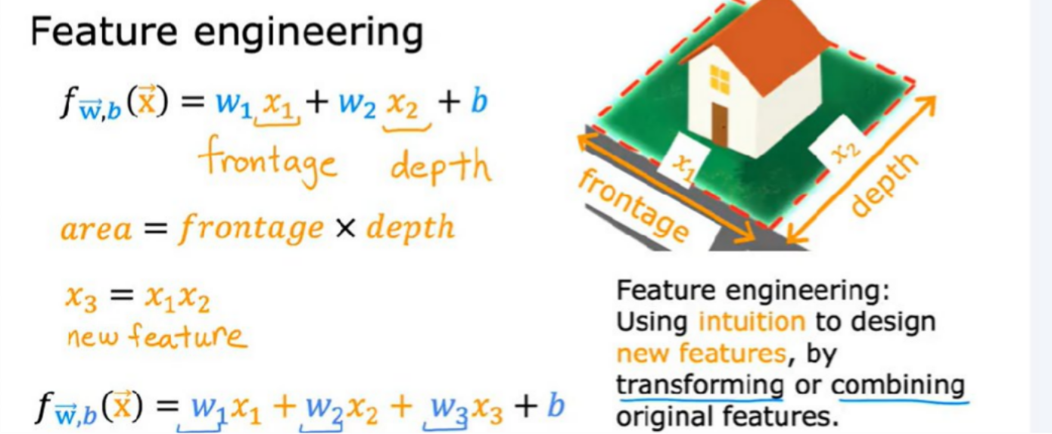
Feature Engineering
Feature engineering is the process of selecting, manipulating and transforming raw data into features that can be used in supervised learning.
For example,we have length and breadth in our data ,but we can use them as area=length*breadth,so now a new feature i.e area.
Rather than just taking the features that you happen to have started off with sometimes by defining new features, you might be able to get a much better model.

Slide 44
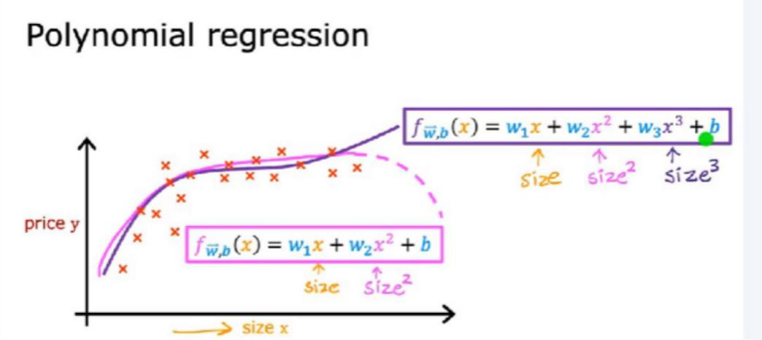
Polynomial regression
Polynomial regression is a regression analysis technique that models the relationship between a dependent variable and one or more independent variables using a polynomial function. Unlike linear regression, which assumes a straight-line relationship, polynomial regression can capture more complex, curved patterns by including higher-degree polynomial terms in the model.
Refer C1_W2_Lab04_FeatEng_PolyReg_Soln
Refer C1_W2_Lab05_Sklearn_GD_Soln

Slide 45
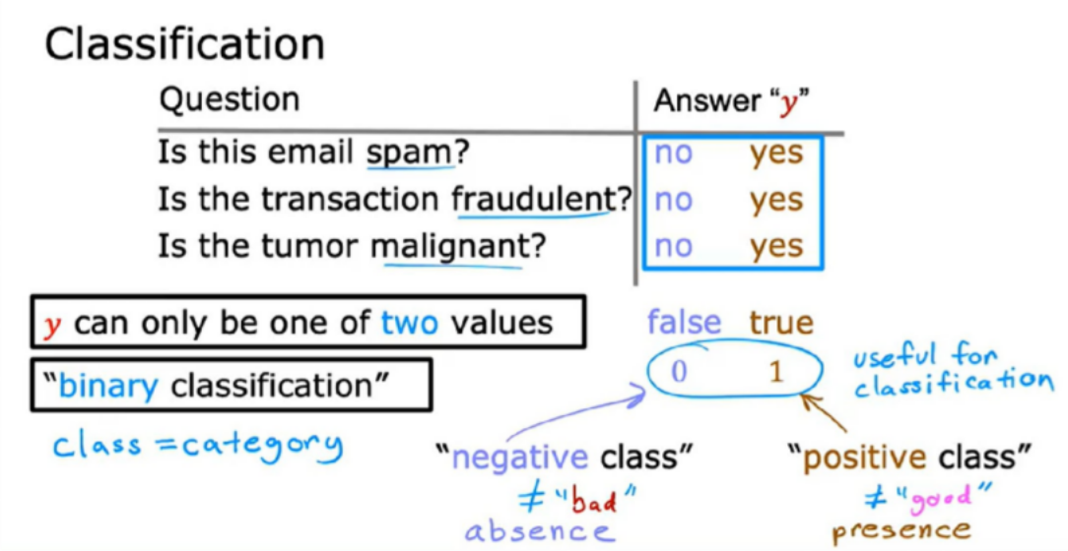
Classification
Classification teaches a machine to sort things into categories. It learns by looking at examples with labels (like emails marked “spam” or “not spam”). After learning, it can decide which category new items belong to, like identifying if a new email is spam or not. For example a classification model might be trained on dataset of images labeled as either dogs or cats and it can be used to predict the class of new and unseen images as dogs or cats based on their features such as color, texture and shape.

Slide 46
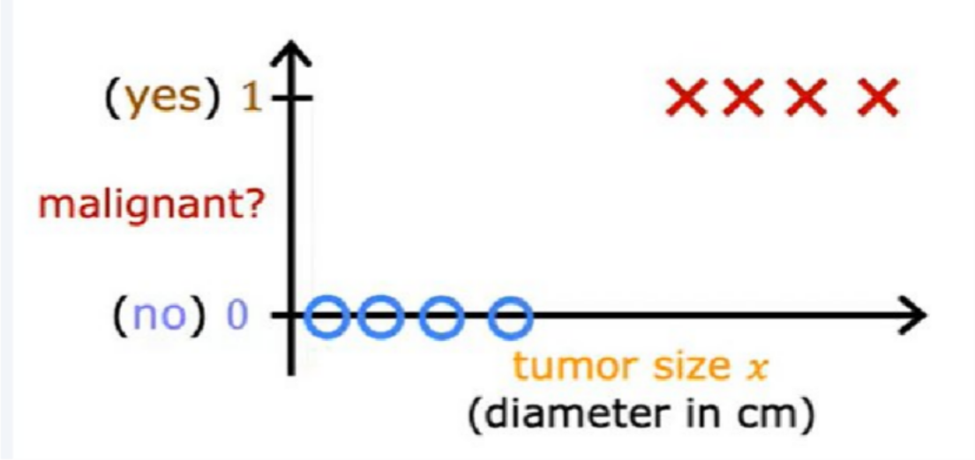
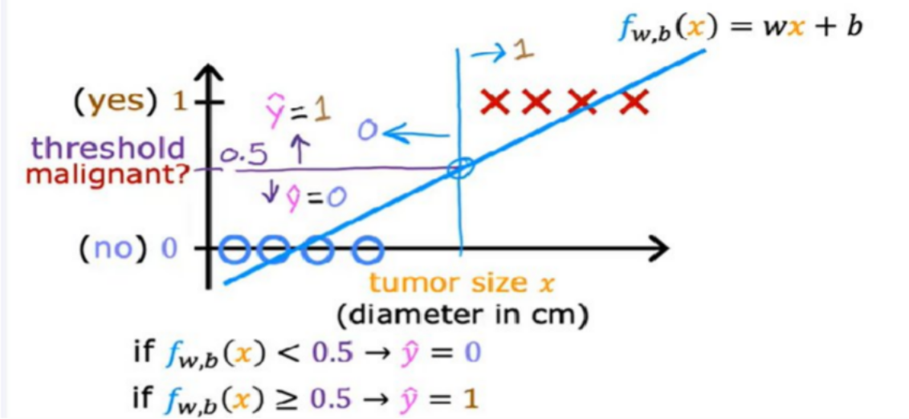

Slide 47
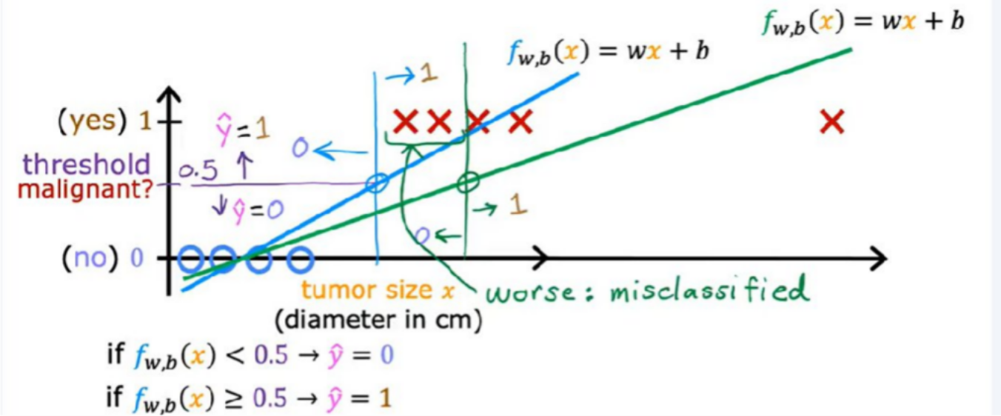
But once you've added this extra training example on the right. The best fit line for linear regression will shift over like this. And if you continue using the threshold of 0.5, you now notice that everything to the left of this point is predicted at zero non malignant. And everything to the right of this point is predicted to be one or malignant. This isn't what we want because adding that example way to the right shouldn't change any of our conclusions about how to classify malignant versus benign tumors.
But if you try to do this with linear regression, adding this one example which feels like it shouldn't be changing anything. It ends up with us learning a much worse function for this classification problem.
Clearly, when the tumor is large, we want the algorithm to classify it as malignant. So what we just saw was linear regression causes the best fit line. When we added one more example to the right to shift over. And does the dividing line also called the decision boundary to shift over to the right.
Refer C1_W3_Lab01_Classification_Soln

Slide 48
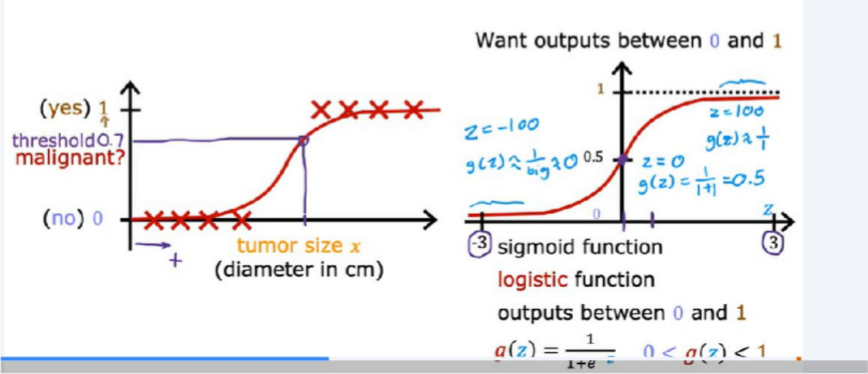
Logistic Regression
Logistic regression is used for binary classification where we use sigmoid function, that takes input as independent variables and produces a probability value between 0 and 1.
z is large, g of z that is a Sigmoid function of z is going to be very close to 1. Conversely, you can also check for yourself that when z is a very large negative number, then g of z becomes 1 over a giant number, which is why g of z is very close to 0. That's why the sigmoid function has this shape where it starts very close to zero and slowly builds up or grows to the value of one.

Slide 49
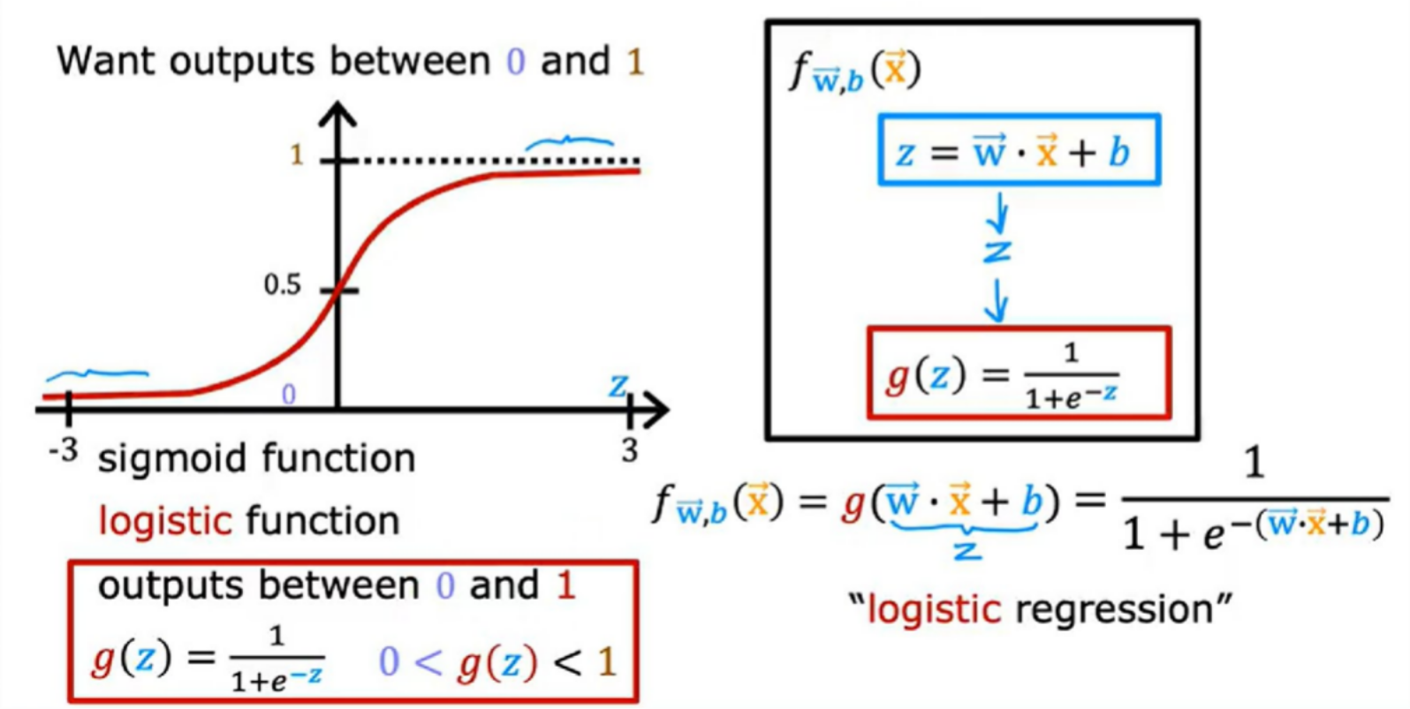

Slide 50

x is the tumor size and y is either 0 or 1, if you have a patient come in and she has a tumor of a certain size x, and if based on this input x, the model I'll plus 0.7, then what that means is that the model is predicting or the model thinks there's a 70 percent chance that the true label y would be equal to 1 for this patient. In other words, the model is telling us that it thinks the patient has a 70 percent chance of the tumor turning out to be malignant.
Refer C1_W3_Lab02_Sigmoid_function_Soln

Slide 51

Whenever f(x)>=0.5 the predicted value is 1 else 0.
So if we say f(x)>=0.5 i.e g(z)>=0.5 which means z>0 similarly for f(x)<=0.5 i.e z<0 which maeans z<0.

Slide 52

Decision Boundary
A decision boundary is a hypersurface that separates different classes or categories in a feature space. It's the boundary that a classification model learns to distinguish between classes, dictating how it will classify new, unseen data points.Assume w1,w2,and b as 1,1,-3.

Slide 53

So if x1^2+x2^2 is greater than 1 here in this case then consider the outer group as prediction if it is less than 1 then from
the inner group is prediction.

Slide 54

These are few more complex non-linear decision boundaries example

Slide 55

Cost function for Logistic Regression
Remember that the cost function gives you a way to measure how well a specific set of parameters fits the training data. Thereby gives you a way to try to choose better parameters.

Slide 56


Slide 57
Logistic loss function
The loss function measures how well you're doing on one training example, and by summing up the losses on all of the training examples, you get the cost function, which measures how well you're doing on the entire training set.
Purpose:
The logistic loss function measures how well a model's predicted probabilities align with the true binary labels.
It's crucial for training logistic regression models, where the goal is to predict the probability of a data point belonging to a specific class.
It penalizes incorrect predictions more heavily, especially when the model is very confident about the wrong class.

Slide 58

Key points about the formula:
If y = 1 (positive class), the loss is -log(y'), which increases as y' approaches 0.
If y = 0 (negative class), the loss is -log(1 - y'), which increases as y' approaches 1.
This means the loss is minimized when the predicted probability perfectly matches the true label.

Slide 59


Slide 60
Why use logistic loss instead of MSE?
Unlike mean squared error (MSE), logistic loss is specifically designed for binary classification problems and models the non-linear relationship between input features and the probability of a binary outcome.
MSE can be problematic for logistic regression because the sigmoid function (used to map predictions to probabilities) can make the cost function non-convex with multiple local minima.
Logistic loss, being convex, ensures a single global minimum, making optimization easier.

Slide 61



Slide 62


Slide 63

Gradiend descent
To fit the parameters of a logistic regression model, we're going to try to find the values of the parameters w and b that minimize the cost function J(w, b), and we'll again apply gradient descent to do this.

Slide 64


Slide 65
Overfitting:
Overfitting occurs when a model learns the training data too well, including noise and irrelevant details, resulting in poor generalization to new data.
Underfitting:
Underfitting occurs when a model is too simple to capture the underlying patterns in the data, leading to poor performance on both training and new data.

Slide 66


Overfitting

Slide 67
Addressing Overfitting
The number one tool you can use against overfitting is to get more training data. Now, getting more data isn't always an option.
A second option for addressing overfitting is to see if you can use fewer features i.e Feature Selection
Regularization-What regularization does is encourage the learning algorithm to shrink the
values of the parameters without necessarily demanding that the parameter is set to exactly
0. So what regularization does, is it lets you keep all of your features, but they just prevents the features from having an overly large effect, which is what sometimes can cause overfitting.

Slide 68

C1_W3_Lab08_Overfitting_Soln

Slide 69


To recap if lambda is 0 this model will over fit If lambda is enormous like 10 to the power of 10. This model will under fit. And so what you want is some value of lambda that is in between that more appropriately balances these first and second terms of trading off, minimizing the mean squared error and keeping the parameters small. And when the value of lambda is not too small and not too large, but just right, then hopefully you end up able to fit a 4th order polynomial, keeping all of these features, but with a function that looks like this. Increasing the regularization parameter lambda reduces overfitting by reducing the size of the parameters. For some parameters that are near zero, this reduces the effect of the associated features.

Slide 70

C1_W3_Lab09_Regularization_Soln

